Slide 1
Marianna Zhang
Essentially blocked:
The role of structural context in blocking essentialism
Devo brownbag
5.21.19
Notes:
(45 min of content, 1 hr 10 min for slot)
I’d like to talk about some of the ideas I’m interested in, and introduce you all to what I’ve been working on this past year: my first year project.

Slide 2

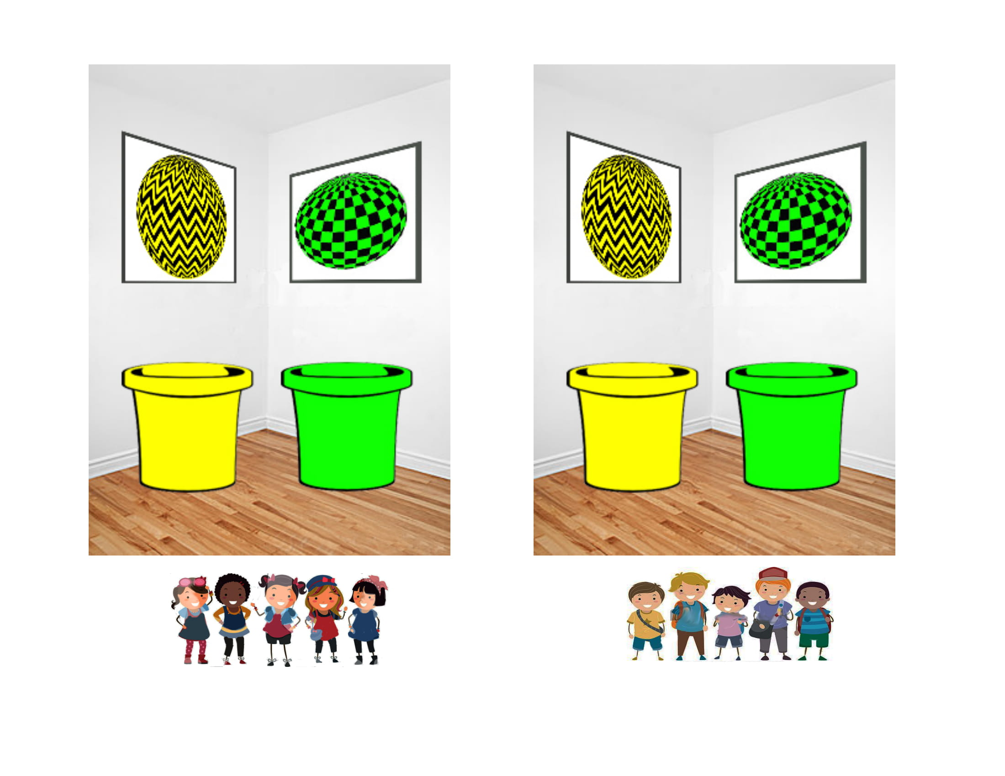







Notes:
Let’s start off with the fact that the world is messy. Yet, we make sense of it all. Rather than a jumbled mess, we see…

Slide 3
Organizing the world into categories
MALE
FEMALE
CHAIR
TABLE
CAT
DOG
Notes:
… we see cats and dogs, chairs and tables, men and women.
Human beings everywhere from a young age naturally and easily organize their experiences using categories. We group individual things together, treating them as alike in some respect, and together different from other things in the world. We consider an individual thing not just as an individual thing, but as one of potentially indefinitely many instances of a category to which it belongs.
Categorization is a powerful cognitive tool that allows us to make rich inferences about the world around us. Categories allow us to go beyond our immediate experience and make inferences about things we’ve never experienced before.

Slide 4


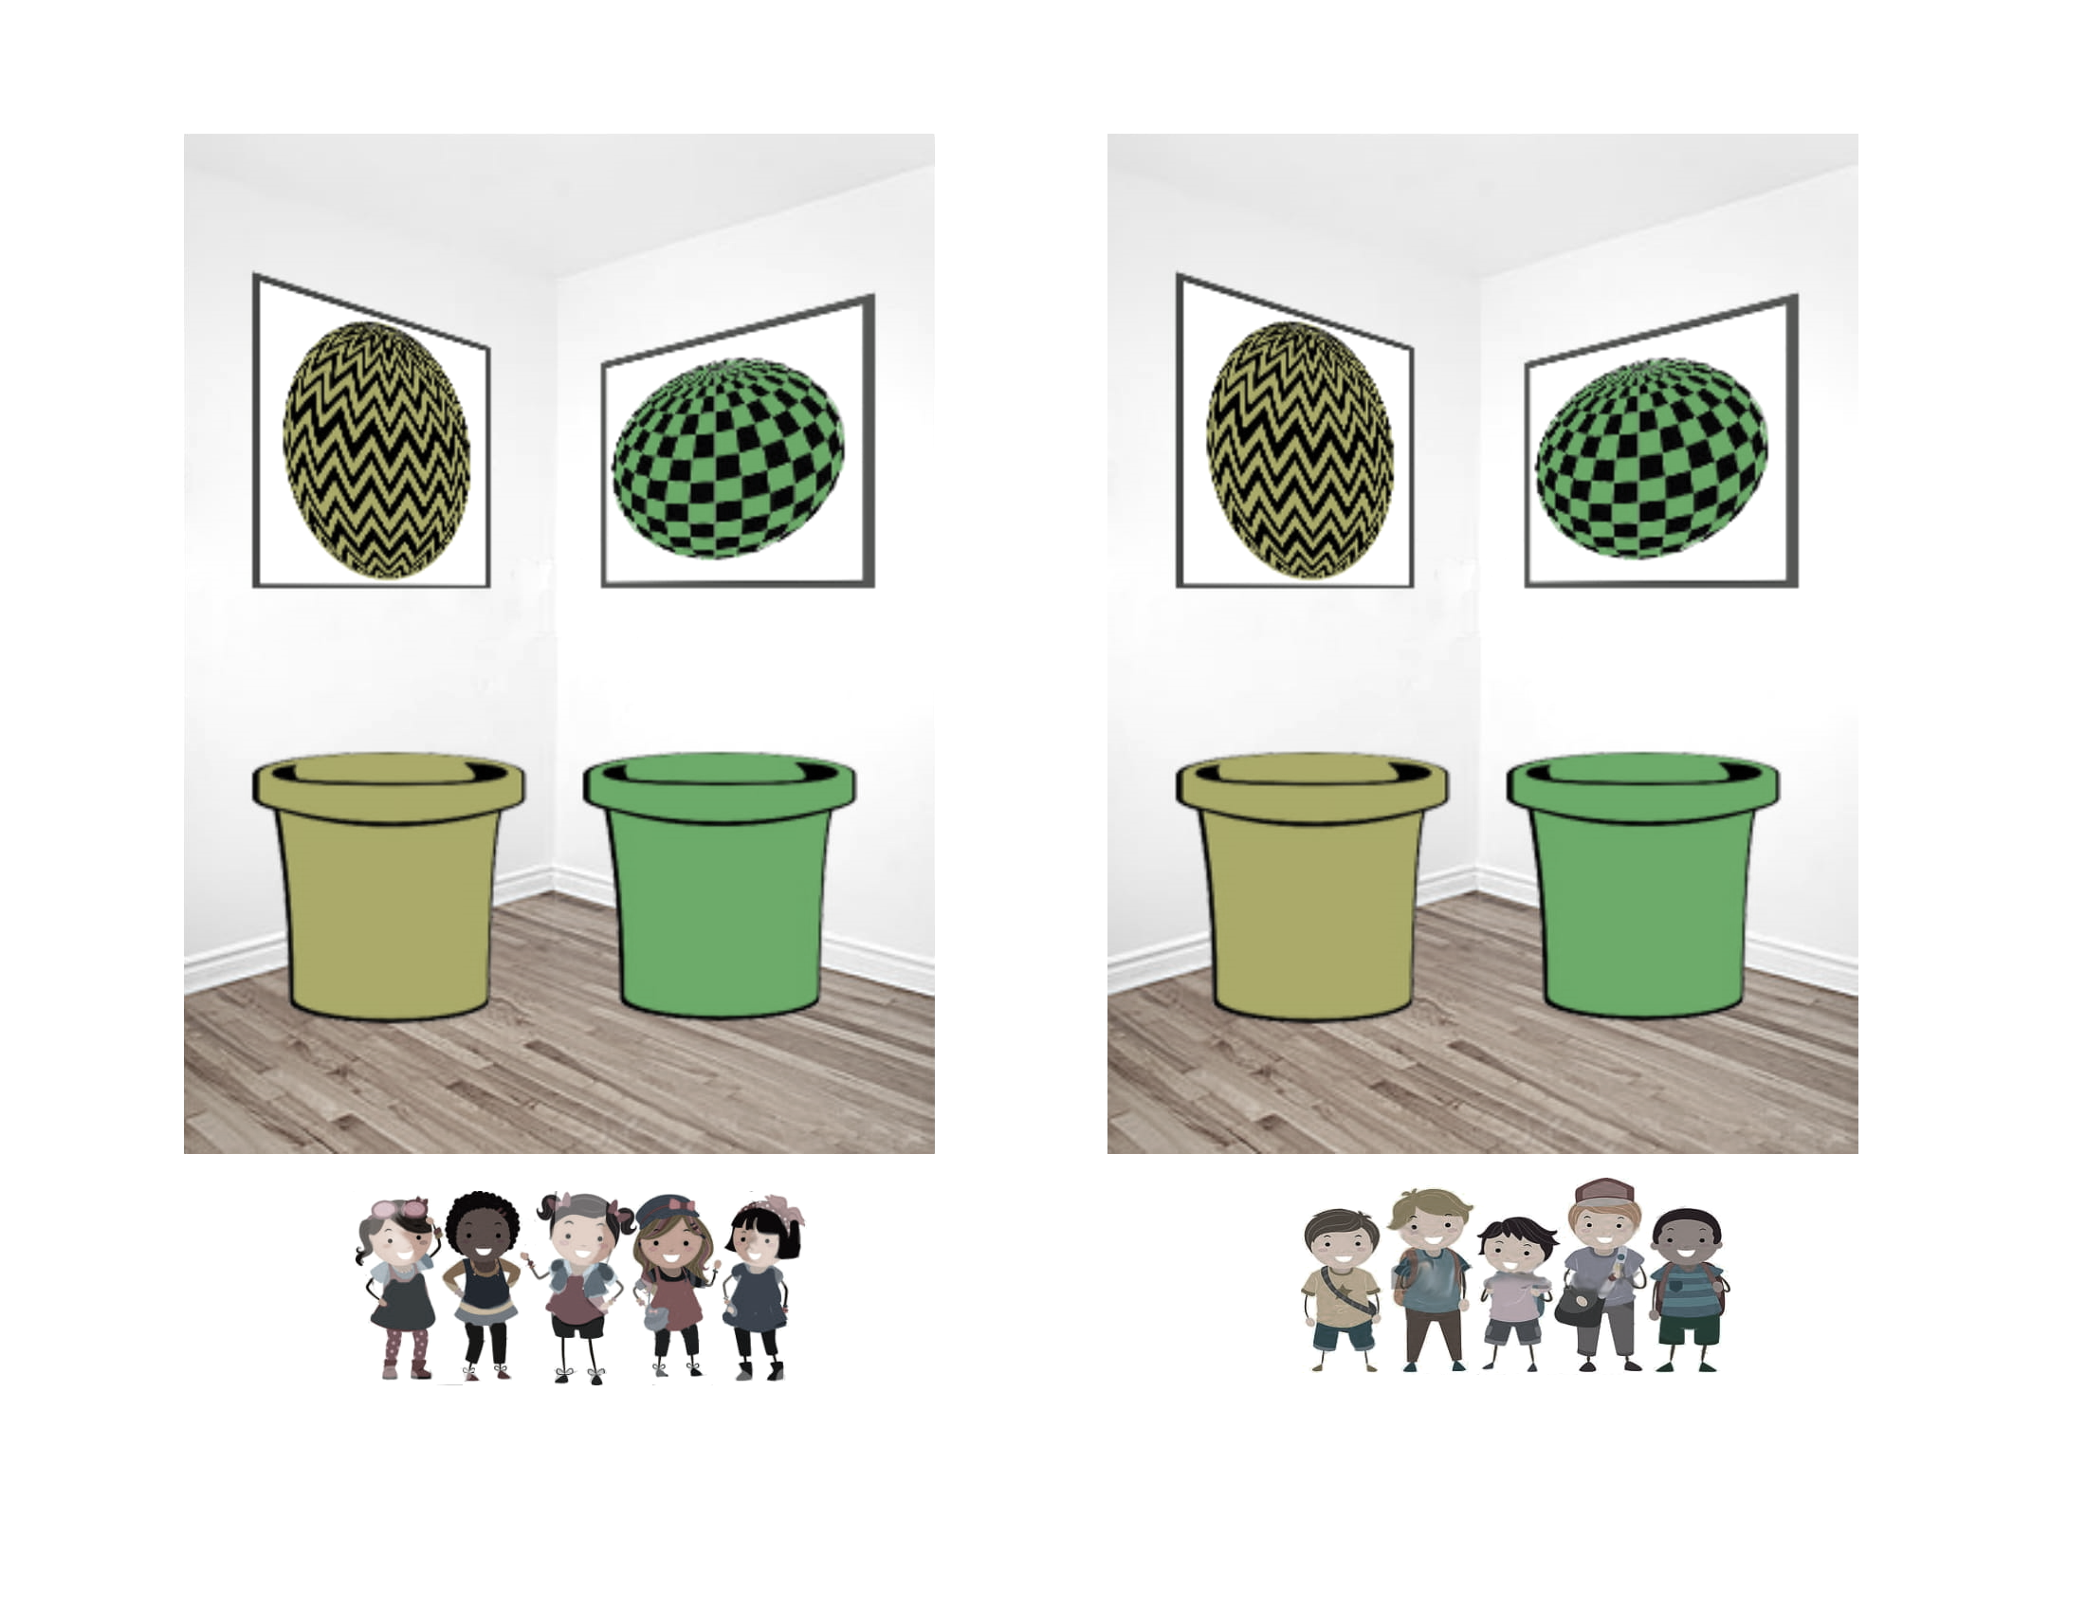




Organizing the world into categories
MALE
FEMALE
CHAIR
TABLE
CAT
DOG
Notes:
- My cohortmate Lauren recently adopted a cat named Milo, who I have yet to meet, but since I know Milo is a cat, I can deploy my CAT category representation to infer that Milo probably meows, probably likes catnip, and probably fights with Lauren’s dog.

Slide 5
Organizing the world into categories
MALE
FEMALE
CHAIR
TABLE
CAT
DOG
Notes:
- My cohortmate Lauren recently adopted a cat named Milo, who I have yet to meet, but since I know Milo is a cat, I can deploy my CAT category representation to infer that Milo probably meows, probably likes catnip, and probably fights with Lauren’s dog.

Slide 6



Organizing the world into categories
MALE
FEMALE
CHAIR
TABLE
CAT
DOG
Notes:
- Although psychologically powerful and pervasive, categories can also lead to pernicious consequences, especially in the social domain, where they can form the basis of stereotyping and prejudice.
- What is the structure of these rich category representations, and how do children develop this structure?

Slide 7
An essentialist construal of categories
Essentialism is a cognitive bias to believe that categories correspond to real categories in the world.
Each category has a unique “essence”, which:
cannot be directly observed.
is stable and unchanging.
gives an object its identity.
causally produces shared properties across category members, which are considered to be innate and fixed at birth.
can be a placeholder notion, need not be articulated.
MALE
FEMALE
male essence
female essence
Gelman 2003/2004
Notes:
One way we could represent the structure of a category is to think about a category in essentialist terms.
Essentialism - cognitive bias to believe that: categories represent real natural distinctions in the world. categories aren’t just arbitrary groupings, but groupings that carve nature at its joints.
Each category has a unique “essence”. Eg there is a male essence for the category of male…
- All category members share this deep underlying “essence”, which can’t be directly observed.
- Essence is stable, unchanging, and gives category members their identity.
- Causally responsible for shared properties among category members. Category members have the innate potential to exhibit these properties, which are fixed and unchangeable. - Could be elaborated/cashed out eg as biological sex, DNA, chemical formula, or something, but could just be a placeholder. Could have an idea that a category possesses an essence, without knowing what that essence is.

Slide 8
A social-structural construal of categories
Categories are situated in a rich social context, which influence the very nature of the category.
Different social-structural forces operating on each category contribute to differences between categories.
MALE
FEMALE
social context of being MALE
social context of being FEMALE
Notes:
Another framework we could use to represent the structure of a category is a social-structural construal. Rich social context. Eg male and female
Eg men and women subject to different expectations, standards, socialization, resources, biases, etc. in our society.
The nature and structure of a category could be interpreted as contingent or even constructed by the social context that it is situated within.

Slide 9
A social-structural construal
An essentialist construal
Notes:
We can contrast these two different construals of categories, comparing them as different ways that people think about categories, bracketing off the metaphysical question of what categories in the world actually are.
When children are developing category representations, how do they choose between these two construals of a given category?
I’ve presented them here as two distinct construals for illustration, but we can consider these two be two points on a theoretical continuum.

Slide 10
A social-structural construal
An essentialist construal
Language provides information about how to represent a category.
Language
Notes:
In this talk, I’ll discuss how language provides important cues about how to represent a category, whether to think about a given category using an essentialist framework, or using a social-structural framework.

Slide 11
An essentialist construal
Language provides information about how to represent a category.
Some forms of language can act as cues to represent certain categories in an essentialist way.
Linguistic cues for essentialism
A social-structural construal
Notes:
I’ll review a line of prior research that examines some different forms of language, and how each of them might cue an essentialist framework.

Slide 12
An essentialist construal
Language provides information about how to represent a category.
Some forms of language can act as cues to represent certain categories in an essentialist way.
A social-structural construal
Contextual factors may affect which construal is adopted.
Notes:
I’ll also review some recent of work that suggests a role for context in whether we conceptualize a category in an essentialist way or in a social-structural way.

Slide 13
An essentialist construal
Language provides information about how to represent a category.
Some forms of language can act as cues to represent certain categories in an essentialist way.
Linguistic cues
A social-structural construal
+
Contextual factors may affect which construal is adopted.
How do children integrate linguistic and contextual information when developing a representation of a category?
Notes:
Lastly, I’ll draw together these various lines of work to motivate my ongoing first-year project, which asks how we integrate linguistic and contextual information to support one of these construals of category structure or another.
Use gender as a case study, since gender is a rich space to pit these construals against each other.

Slide 14
A social-structural construal
An essentialist construal
Language provides information about how to represent a category.
Language
Gelman 2003/2004
Notes:
Although children across various cultural communities essentialize some set of categories, the categories that are essentialized are only a small subset of all the categories that they represent, + there is cultural variation in what particular social categories children essentialize.
> Race – children: politically conservative > liberal in US
> Ethnicity – children: religious > secular communities in Israel
> Class – adults: upper class > lower class in India
> Gender – 5yo essentialism, 10yo and adults think more in social-structural ways (Marianne Taylor).
> Gender – female category essentialized more than male category in India (Mahalingam, 2003a)
role of social input (e.g. language) in guiding children to essentialize particular categories
* Hyo: does input override essentialism, or does input shapes which framework to go for
> Input shapes which framework to use, although certain types of language might have default modes of interpretation. eg generics and formal explanations might be interpreted in an essentialist way by default, unless context is present. Context as “blocking” essentialism. Even what counts as a generic: no reliable linguistic form, the default might be a generic (Birds fly) and then when we add specificity and tense etc (Leslie? cited by Susan), no longer a generic (Birds fly outside my window in the morning).

Slide 15
A social-structural construal
An essentialist construal
the property is non-accidental and conceptually central to that category
Generic language
“Dogs bark.”
“A dog barks.”
Rhodes, Leslie, & Tworek, 2012; Cimpian & Markman 2009/2011
Notes:
What kinds of language might cue children to essentialize a category?
Generic language – describe a category as a whole. Potentially powerful, because our experience is filled with individual things, and generic language is a simple way of communicating a generalization about a whole category. suggest that the property is causally relevant, non-accidental, conceptually central
4yo who heard generic language about a novel social category (“Zarpies sleep in trees” or “A Zarpie sleeps in trees”) -> develop essentialist beliefs about that social category. explained the presence of properties in terms of intrinsic causes, considered properties to be innate, and extended properties of a single category member to other category members.
children hear a lot of generic language in their environment, eg in parents’ speech to children, ecologically valid as a cue for essentialism.
Parents who were induced to hold essentialist beliefs about a novel social category (Zarpies are a distinct kind of people, biologically and culturally different from others) produced more generics when reading a book about Zarpies to their children
Other linguistic cues – formal explanations?
>Ellen: there isn’t a single syntactic marker that marks something as generic -> recruit other info about predicate, category, etc to decide if something is a generic

Slide 16
A social-structural construal
An essentialist construal
Formal explanations
“Fido barks because Fido is a dog.”
Notes:
Formal explanations

Slide 17
Formal explanations
An essentialist construal
“Fido barks because Fido is a dog.”
An individual has a property because it is a member of a particular category.
Formal explanations directly link an individual and a property to an entire category.
A social-structural construal
Prasada & Dillingham 2006/2009
Notes:
directly link an individual + a property to an entire category → could support learning about an entire category from a single individual → potentially powerful cues to category structure
Formal explanations present a real puzzle: almost tautological sounding. If we ask someone, “Why does Fido bark?” and they answer “because Fido is a dog”, well we already knew that Fido was a dog, that part isn’t new or informative. Yet we do seem to be gleaning something useful from hearing the explanation, and they sound natural and meaningful to us.

Slide 18
Formal explanations
An essentialist construal
“Fido barks because Fido is a dog.”
An individual has a property because it is a member of a particular category.
Formal explanations directly link an individual and a property to an entire category.
A social-structural construal
Formal explanations are felicitous iff the property is an aspect, a central part of what it means to be a category member.
# “This barn is red because it is a barn.”
Prasada & Dillingham 2006, Exp 2a; Prasada & Dillingham 2009
Notes:
- What we do know: metalinguistic judgments from adults, in the context of deriving various kinds of category properties (eg merely statistical, conceptually central, etc)
- “Fido barks because Fido is a dog” rated as a good expl (5/7). “This barn is red because it is a barn” is rated by native English speaking adults as not good (3/7), even though statistically common.
- Me: personally interested in formal explanations, bc my interest in devo psych started w work I did w Susan Carey on formal explanations and normative expectations about category members possessing the property. Inspired by work on generics, I had been thinking about whether formal explanations also lead to essentialism.

Slide 19
A social-structural construal
An essentialist construal
the property is an inherent property of that category
Formal explanations
“Fido barks because Fido is a dog.”
Gelman, Cimpian, & Roberts, 2018
Notes:
Formal explanations not only pick out an aspect of what it means to be a category member, but often suggest that there is something inherent about the category that gives rise to that property. Serve as placeholders for an inherent, essentialist explanation.

Slide 20




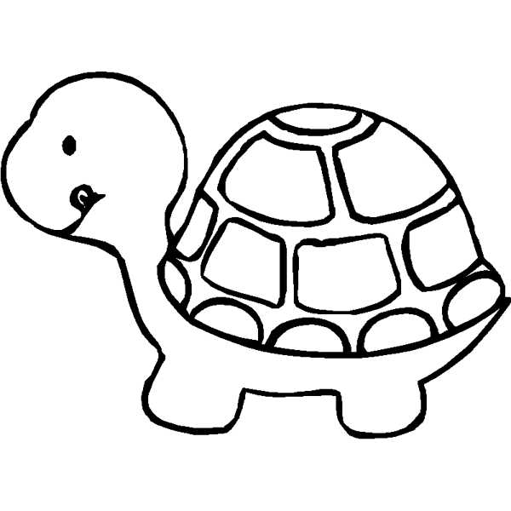



Formal explanations as a cue for essentialism
Animals
Gender
4 trials:
2 novel behaviors 2 novel behavioral preferences
Control explanation
It’s an elephant. It flaps its ears to cool off.
Control explanation
Margaret is a girl. She likes to eat gooseberries.
Formal explanation
It flaps its ears to cool off because it is an elephant.
Formal explanation
Margaret likes to eat gooseberries because she is a girl.
5 canonical essentialism measures after each trial
N = 104 (52/cell) 5 and 6 year olds
N = 93 (46/cell) 5 and 6 year olds
Muradoglu, Marchak, Cimpian, & Gelman, 2019
Notes:
Work presented at SRCD this year
4 diff animals: Cleans itself with its beak, flaps its ears to cool off, likes to sleep standing up, likes to eat lettuce
4 diff girls: Rides on the white horse on merry-go-rounds, puts her left sock on first, likes books about a country called Switzerland, likes to eat gooseberries -> all 5 DVs after each trial

Slide 21
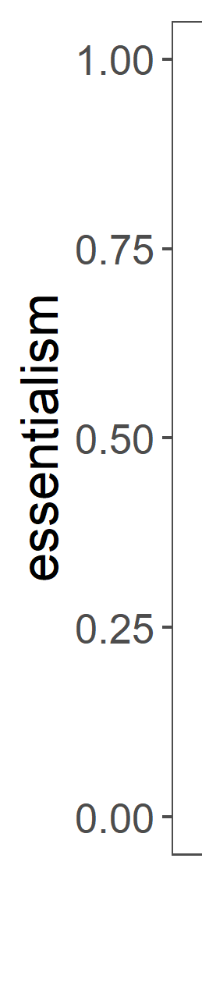
A canonical essentialism battery
5 items x 4 trials averaged into essentialism score per participant
Stability past | Now, here’s a question for you: Margaret is 8 years old. Do you think she liked to eat gooseberries when she was 4 years old? (Y/N)
Stability future | Do you think she will always like to eat gooseberries? (Y/N)
Innateness stop | Would Margaret stop liking to eat gooseberries if her family tried to stop her from eating gooseberries? (Y/N)
Innateness switch | Would Margaret like to eat gooseberries if she grew up in a family where no one liked to eat gooseberries? (Y/N)
Inductive potential | Do you think “just this girl,” “a few girls,” or “a whole lot of girls” like to eat gooseberries? (3-point)
Notes:
Items in this order, w innateness items in random order
1 = higher essentialism
0 = lower essentialism

Slide 22
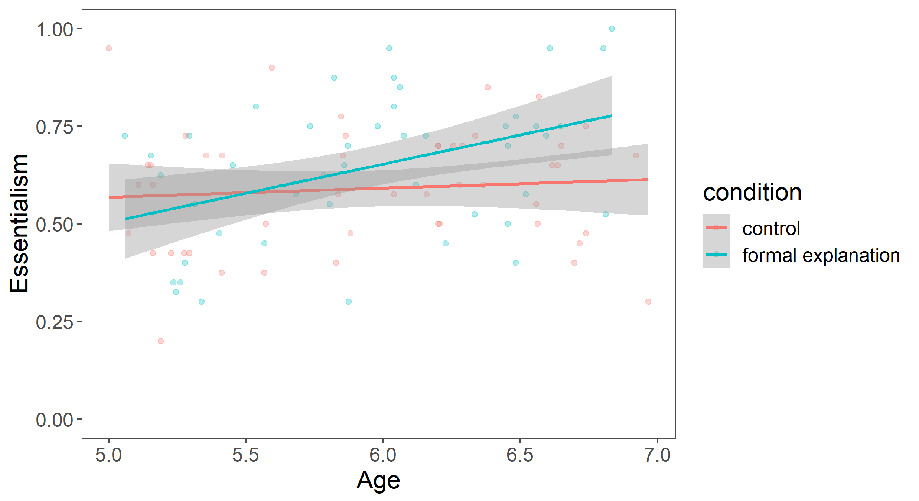
Animals
essentialism = 5 canonical essentialism items x 4 trials
Gender
Bands = SE
N = 104 (52/cell) 5 and 6 year olds
N = 93 (46/cell) 5 and 6 year olds
Muradoglu, Marchak, Cimpian, & Gelman, 2019
Notes:
Essentialism on the y-axis, age on the x-axis

Slide 23
Formal explanations can cue essentialism for animal and gender categories.
Animals
essentialism = 5 canonical essentialism items x 4 trials
Gender
main effect of explanation
explanation * age interaction
Bands = SE
main effect of explanation
N = 104 (52/cell) 5 and 6 year olds
N = 93 (46/cell) 5 and 6 year olds
Muradoglu, Marchak, Cimpian, & Gelman, 2019

Slide 24
A social-structural construal
An essentialist construal
the property is an inherent property of that category
Formal explanations
“Fido barks because Fido is a dog.”
Notes:
Previous work has suggested that formal explanations can be a cue for essentialism, perhaps because they pick out the property as an inherent property of the category.

Slide 25
A social-structural construal
An essentialist construal
Formal explanations may be compatible with either construal, depending on background contextual information.
Formal explanations
“Fido barks because Fido is a dog.”
Notes:
But here, I want to argue that actually, formal explanations can be ambiguous in a really interesting way. It’s true, sometimes we use them and interpret them in an essentialist way. But other times, I think we use them and interpret them in a non-essentialist, social-structural way.

Slide 26
A social-structural construal
An essentialist construal
Formal explanations may be compatible with either construal, depending on background contextual information.
Formal explanations
“Fido barks because Fido is a dog.”
+
Gelman, Cimpian, & Roberts, 2018
Notes:
- In particular, when appropriate information about the social-structural context is available, we may use and interpret formal explanations in this latter way.
- I’ll first present some intuitive reasons for the plausibility of formal explanation having this alternate social-structural interpretation, and then I’ll talk about a prior study that hints at this possibility as well.

Slide 27
Formal explanations may be compatible with either construal, depending on background contextual information.
“Spot can’t enter the cafeteria because Spot is a dog.”
“I walk in groups late at night because I’m a woman.”
“Rosa Parks couldn’t sit in the front of the bus because she was black.”
Social-structural factors
stable extrinsic factors that act on a category by virtue of where the category is situated within a larger social structure
e.g. the social status, treatment, and experience of women in our society
The social experience of being a category member becomes part of what it means to be a category member
CATEGORY
social context
Haslanger, 2016
Notes:
First, the intuitive reasons. So this project was in large part inspired by noticing formal explanations in the wild around me that didn’t seem to fit into the essentialist mould
- Sound like perfectly felicitous formal ex to me, but I don’t think we produce or interpret these with an essentialist construal in mind. There’s nothing inherent about… - Rather, I think what we have in mind is the social-structural context. Dogs live in a human society…
- Returning to the idea of what makes for a felicitous formal explanation, I’d argue that the social experience of being a woman is can be part of what it means to be a woman. More broadly, the social context that is confounded with category membership becomes integrated into what it means to be a category member.
- As a result, it seemed plausible to me that formal explanations could have a viable social-structural, rather than essentialist, interpretation.

Slide 28
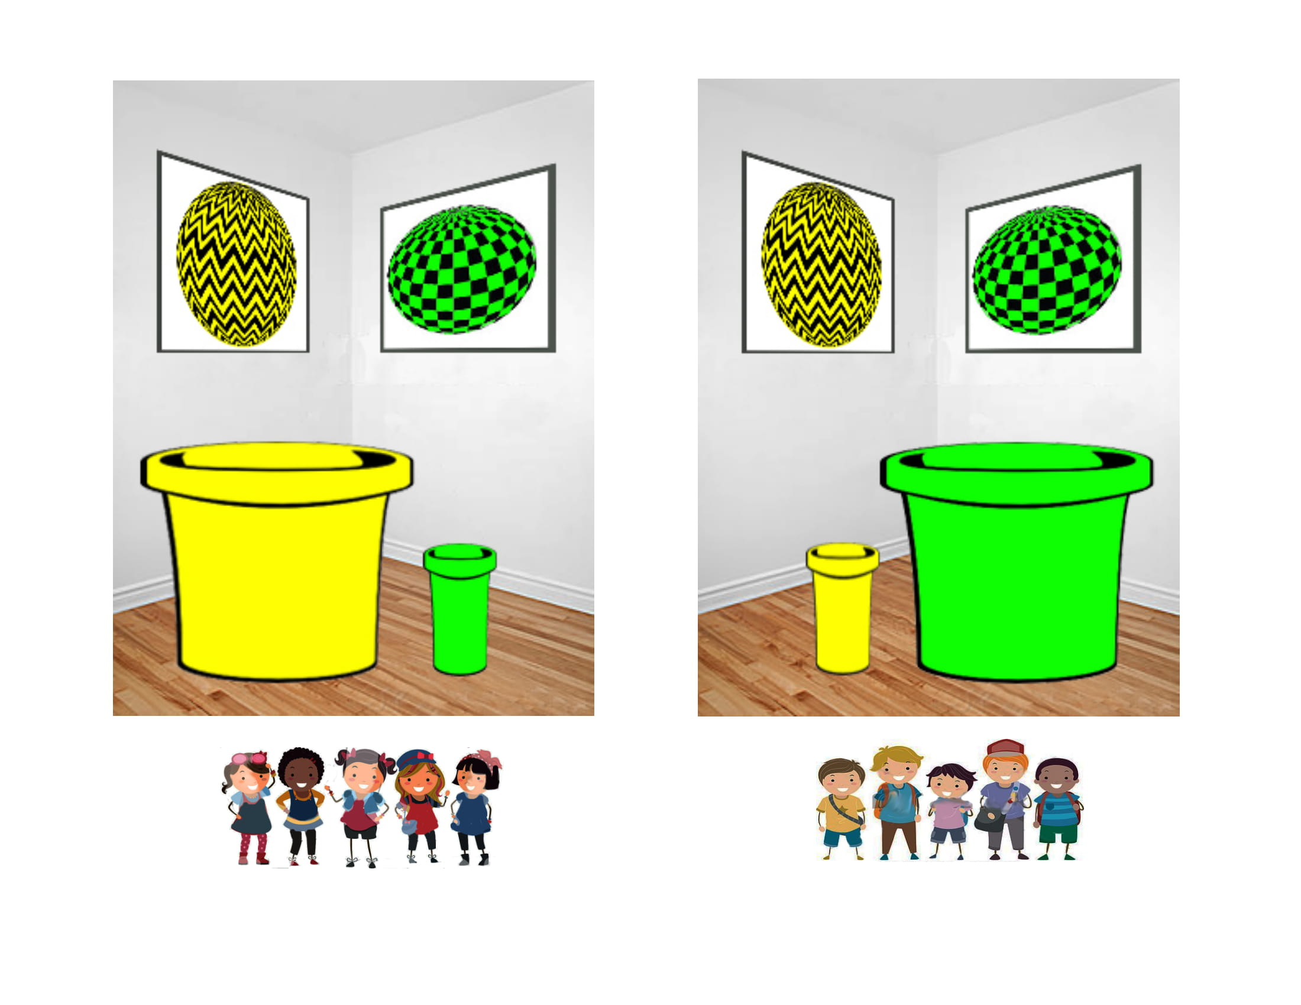
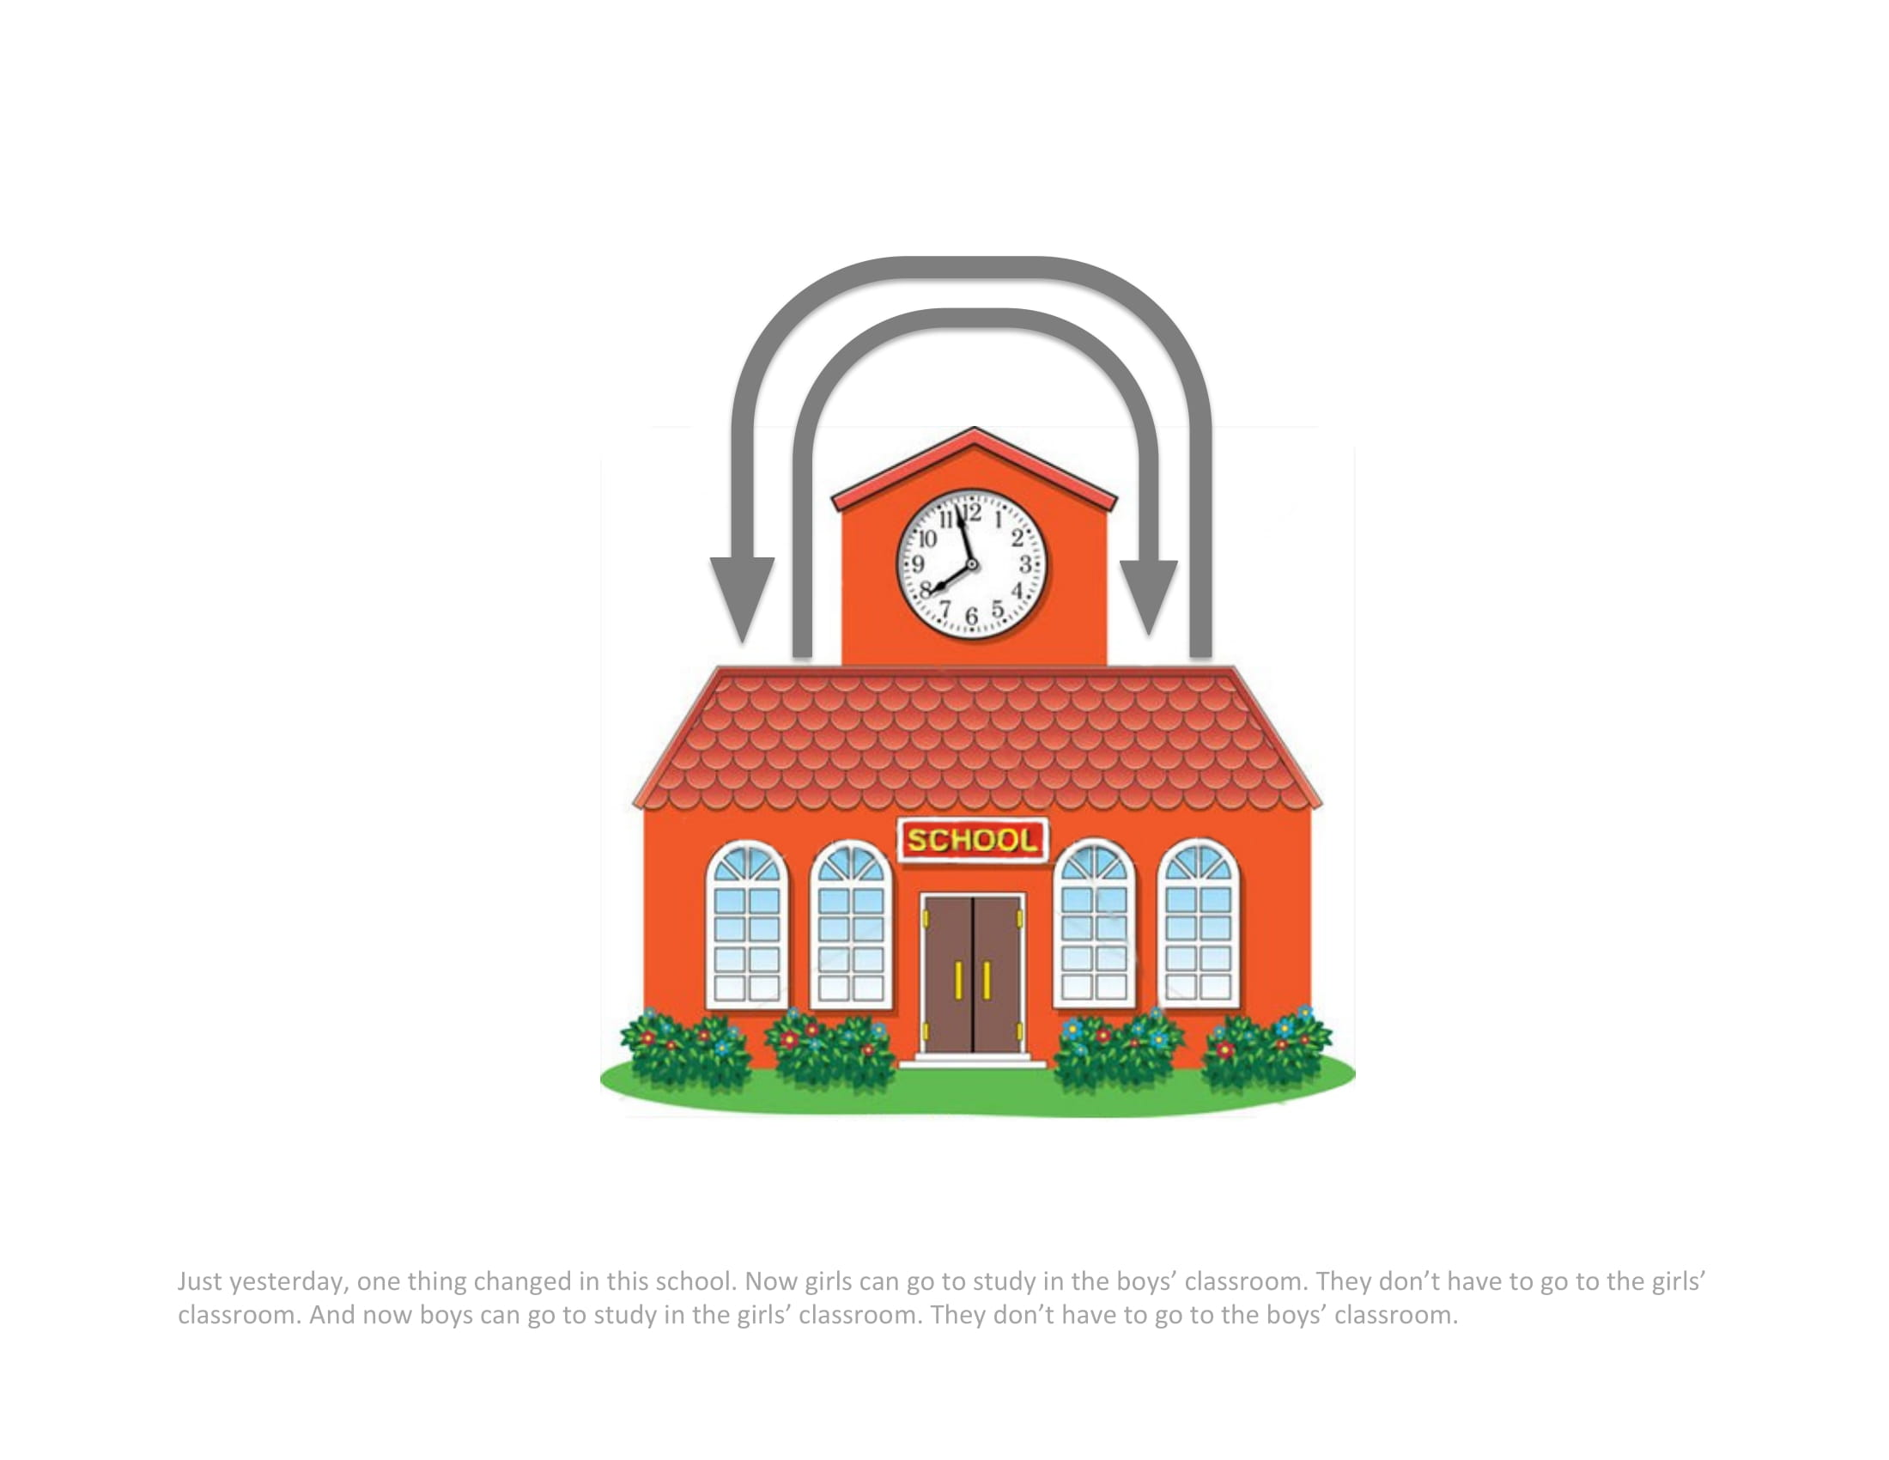
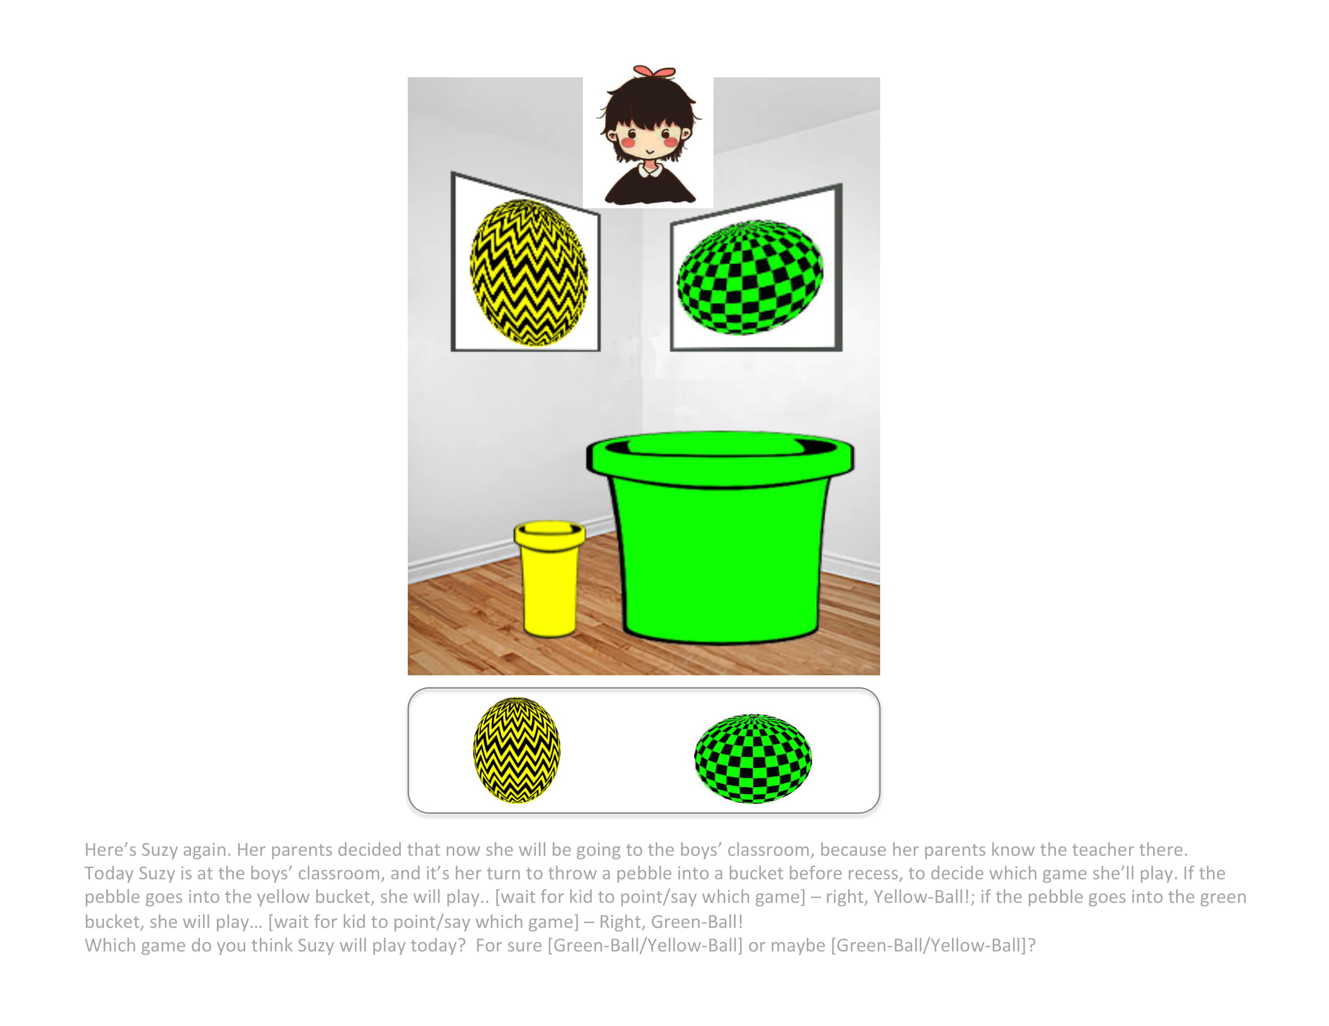
Children are sensitive to structural factors.
1 trial:
a novel behavior (playing a game)
Nonstructural context
Structural context
1 essentialism measure (innateness: context switch)
formal explanation rating
“Doggie, why does Suzy play Yellow-Ball?”
Doggie: “Because Suzy is a girl.”
Is it a good explanation or a bad explanation? (4-point)
Vasilyeva, Gopnik, & Lombrozo, 2018
N = 41 (20/cell) 3-4 year olds, 48 (24/cell) 5-6 year olds, 67 (33/cell) adults
Notes:
The possibility that formal explanations could have this alternate social-structural interpretation was hinted at by Vasilyeva et al 2018
Whether children can reason about social-structural factors in the context.
Setup – A school with gender-segregated classrooms, where students decide which of 2 novel games they’ll play at recess – Yellow-Ball or Green-Ball – by tossing a pebble into a bucket in their classroom.
A number of measures, two of which are relevant for us. Always in this order. What were the results? Start with essentialism measure.

Slide 29
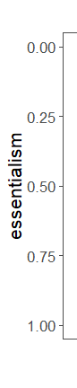
Children are sensitive to structural factors.
Error bars = 1 SEM
1 essentialism measure (innateness: context switch)
formal explanation rating
“Doggie, why does Suzy play Yellow-Ball?”
Doggie: “Because Suzy is a girl.”
Is it a good explanation or a bad explanation? (4-point)
Vasilyeva, Gopnik, & Lombrozo, 2018
N = 41 (20/cell) 3-4 year olds, 48 (24/cell) 5-6 year olds, 67 (33/cell) adults
Notes:
Called this measure mutability, and we can think of it as a reversed essentialism score. Higher = more mutable / less essentialist. Plot by age.

Slide 30
Children are sensitive to structural factors.
Differential structural factors encourage a social-structural rather than essentialist construal.
Error bars = 1 SEM
1 essentialism measure (innateness: context switch)
formal explanation rating
“Doggie, why does Suzy play Yellow-Ball?”
Doggie: “Because Suzy is a girl.”
Is it a good explanation or a bad explanation? (4-point)
Vasilyeva, Gopnik, & Lombrozo, 2018
N = 41 (20/cell) 3-4 year olds, 48 (24/cell) 5-6 year olds, 67 (33/cell) adults
Notes:
Children and adults think of the property as more mutable, ie they are less essentialist, in a structural context than in a nonstructural context.

Slide 31
Children are sensitive to structural factors.
Differential structural factors encourage a social-structural rather than essentialist construal.
Formal explanations are equally felicitous in structural and nonstructural contexts.
Error bars = 1 SEM
1 essentialism measure (innateness: context switch)
formal explanation rating
“Doggie, why does Suzy play Yellow-Ball?”
Doggie: “Because Suzy is a girl.”
Is it a good explanation or a bad explanation? (4-point)
Vasilyeva, Gopnik, & Lombrozo, 2018
N = 41 (20/cell) 3-4 year olds, 48 (24/cell) 5-6 year olds, 67 (33/cell) adults
Notes:
- With the caveat that not sure how much to trust metalinguistic judgments from children: formal explanations are equally felicitous in both contexts, despite each context eliciting different construals. A formal explanation can be considered felicitous even the category is considered in a social-structural rather than essentialist framework.
> Adults – think it's so-so? Natural sounding, but perhaps not satisfying, not fully informative (cf Gelman, Cimpian, Roberts). depending on for what audience?
> metalinguistic judgment vs interpretation disassociable. get a direct measure, motivate my study
Conclusion from Vasilyeva et al 2018 is that children are sensitive to structural factors.
This work tested the effect of context on essentialism separately from the effect of context on the felicity of formal explanations, and didn’t probe how people are interpreting the formal explanation, just whether the explanation is felicitous.
Hints that the interpretation of the formal explanation may depend on the context

Slide 32
Can information about a structural context block an essentialist interpretation of a formal explanation?
N = 38 (~9/cell) out of target 196 (49/cell) 5-6 year olds from Bing Nursery School, Tech Museum
N = 183 (46/cell) adults from Amazon Mechanical Turk
2x2 design
Context > Statistical evidence of property > Explanation > Measure essentialism
(Vasilyeva, Lombrozo, & Gopnik, 2018)
(Muradoglu et al, 2019)
(new!)
Structural context
Formal explanation
Nonstructural context
Control statement
Notes:
- This was the question I wanted to probe in my first year project
- 5-6yo: 3 reasons. 1) by age 5, children have achieved an important precursor to gender essentialism: gender constancy, gender can persist over superficial changes (eg change in dress, appearance) 2) they can reason about structural factors (Vasilyeva et al), 3) past studies looking at formal explanations and essentialism have used this age group.
- Adults as a comparison class - Used same paradigms and manipulations from previous 2 studies, wanted to stick as closely as possible. You may find some quibbles with the details of this setup, I certainty have some minor quibbles, but we wanted to build on what the previous studies found, so we stuck as closely as possible.

Slide 33
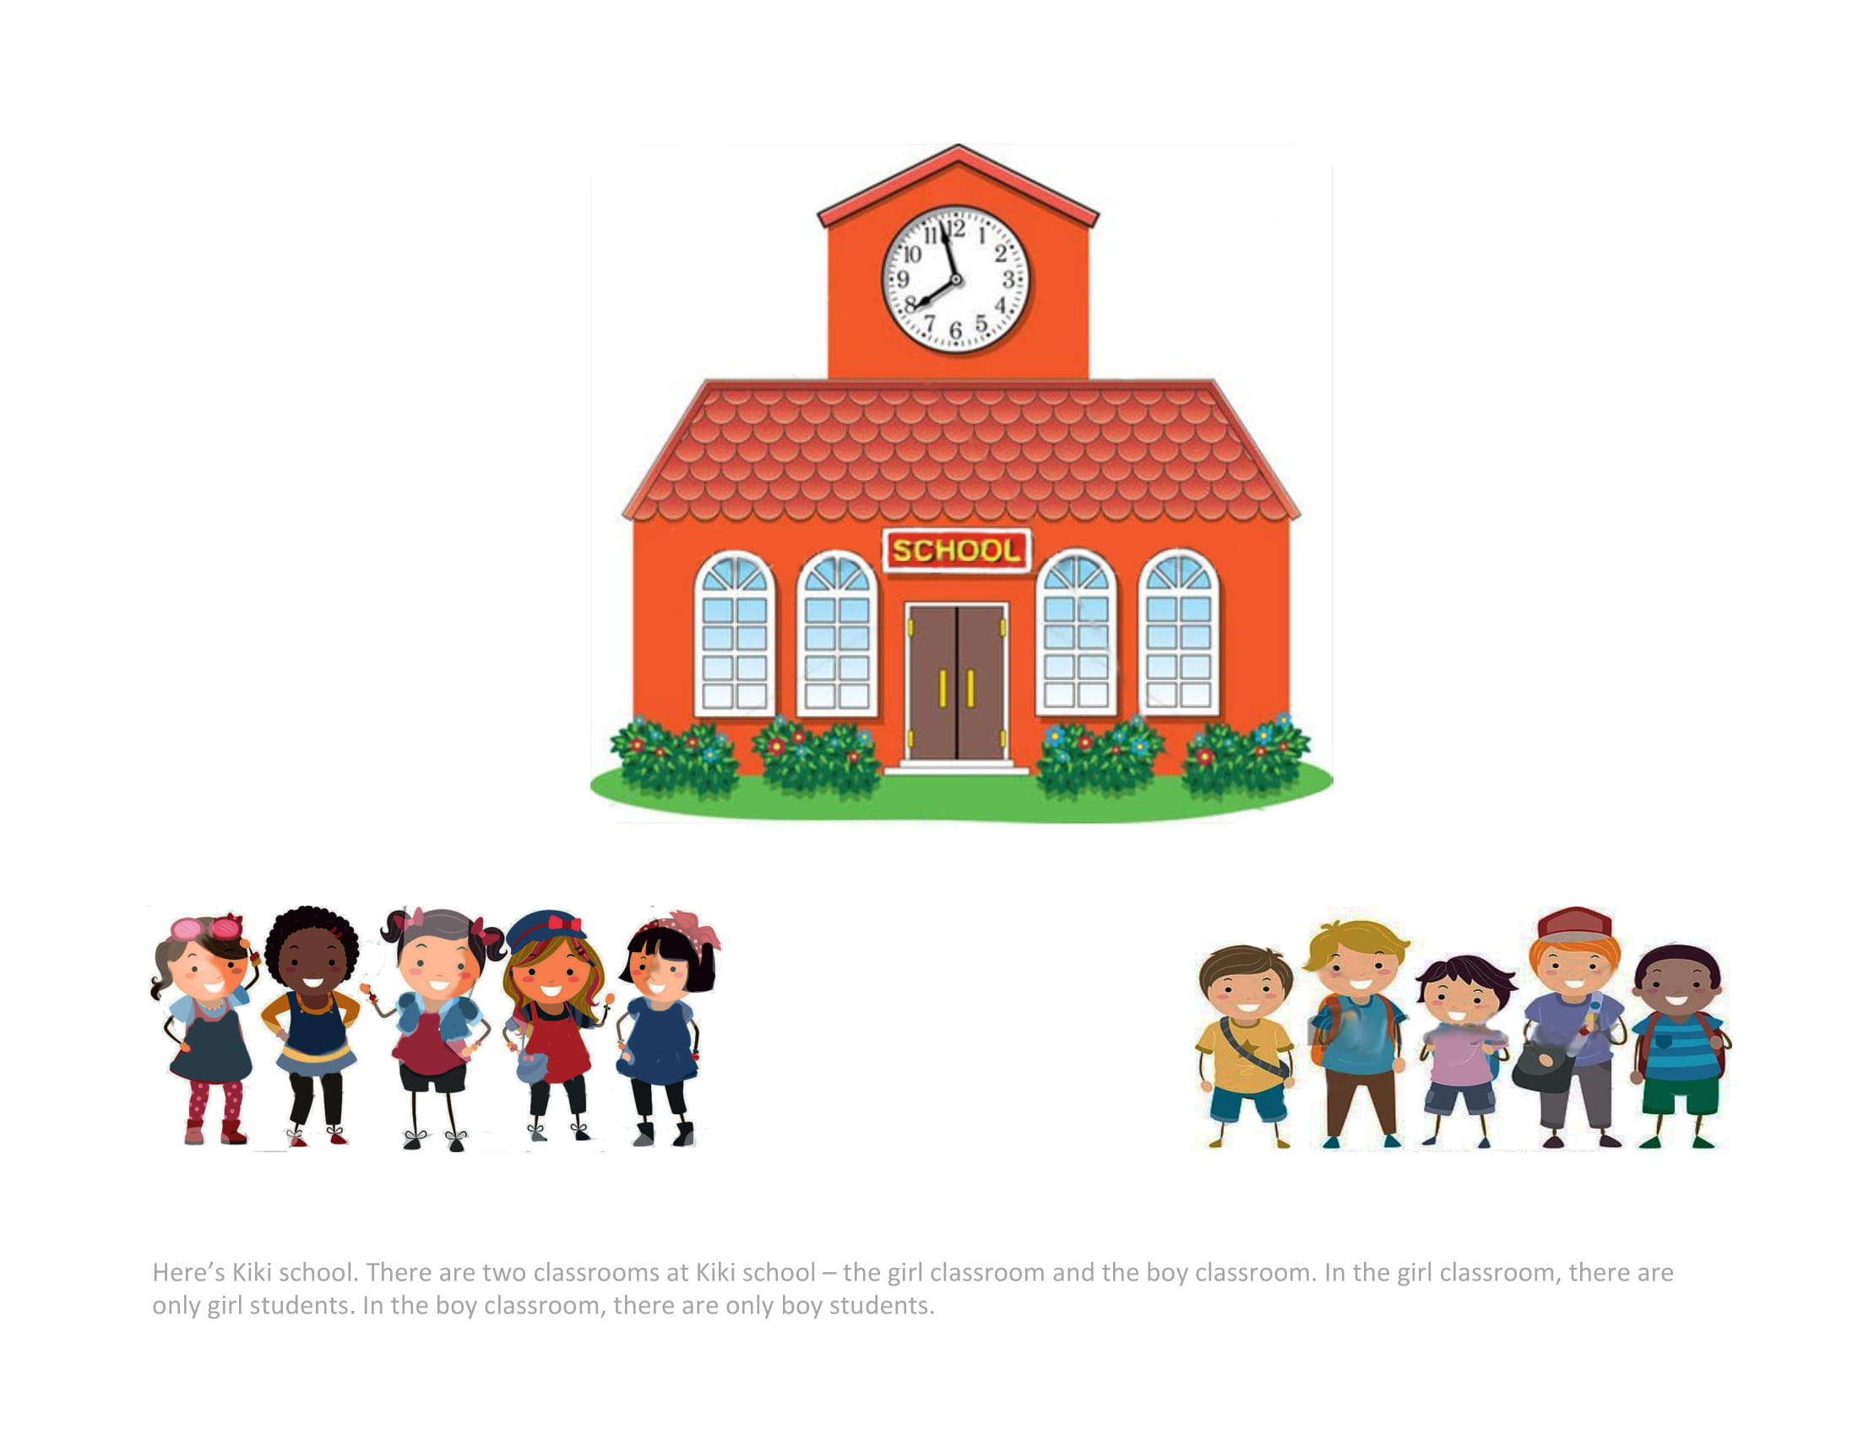
Context > Statistical evidence of property > Explanation > Measure essentialism
Gender-segregated classrooms
borrowed from Vasilyeva, Gopnik, & Lombrozo, 2018
Notes:
Here's Kiki school. There are two classrooms at Kiki school - the girl classroom and the boy classroom. In the girl classroom, there are only girl students. In the boy classroom, there are only boy students.

Slide 34
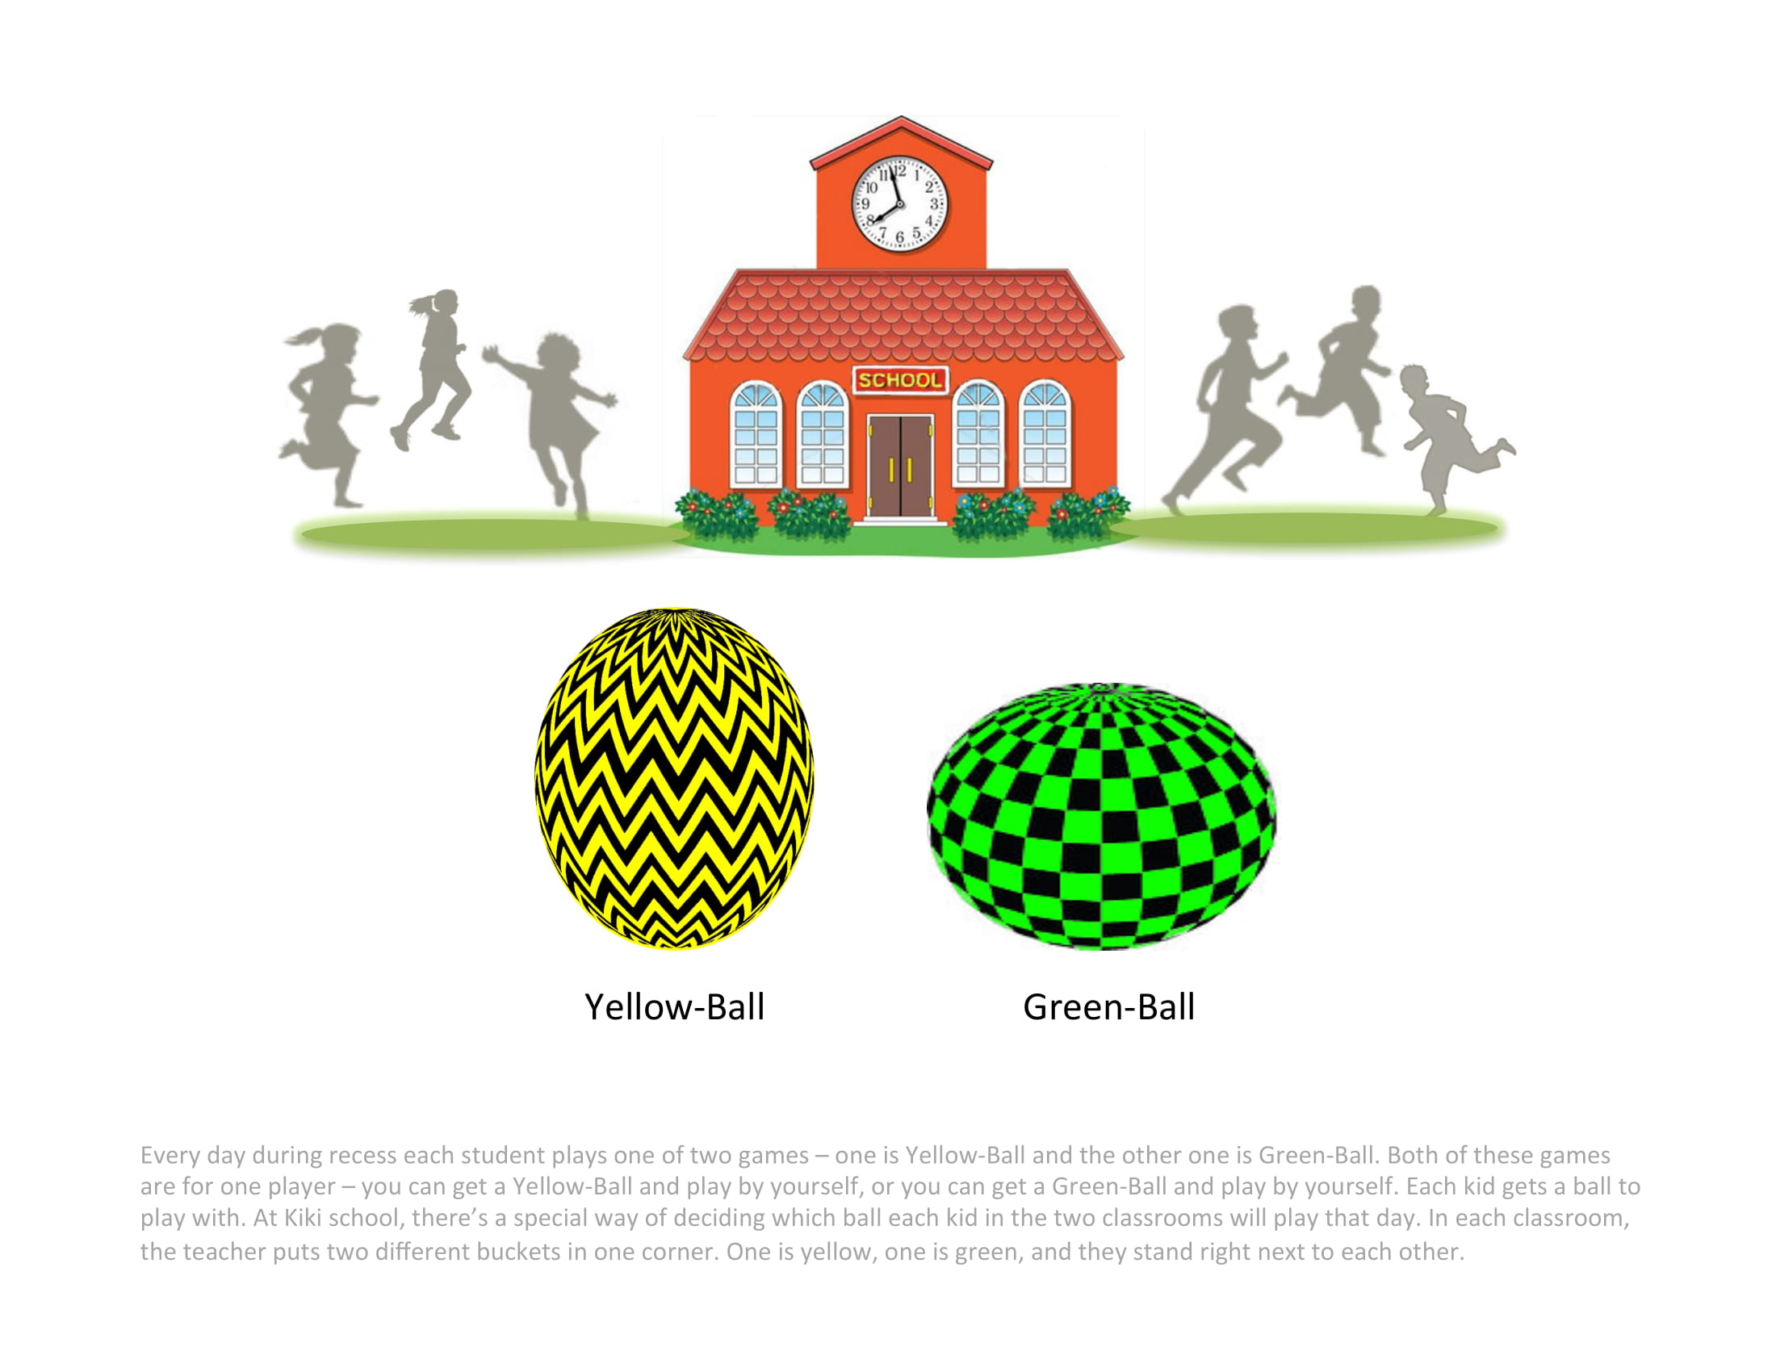
Context > Statistical evidence of property > Explanation > Measure essentialism
Gender-segregated classrooms
Novel behavior (playing games)
borrowed from Vasilyeva, Gopnik, & Lombrozo, 2018
Notes:
Every day during recess each student plays one of two games – one is Yellow-Ball and the other one is Green-Ball. Both of these games are for one player – you can get a Yellow-Ball and play by yourself, or you can get a Green-Ball and play by yourself. Each kid gets a ball to play with. At Kiki school, there’s a special way of deciding which ball each kid in the two classrooms will play that day. In each classroom, the teacher puts two different buckets in one corner. One is yellow, one is green, and they stand right next to each other.

Slide 35
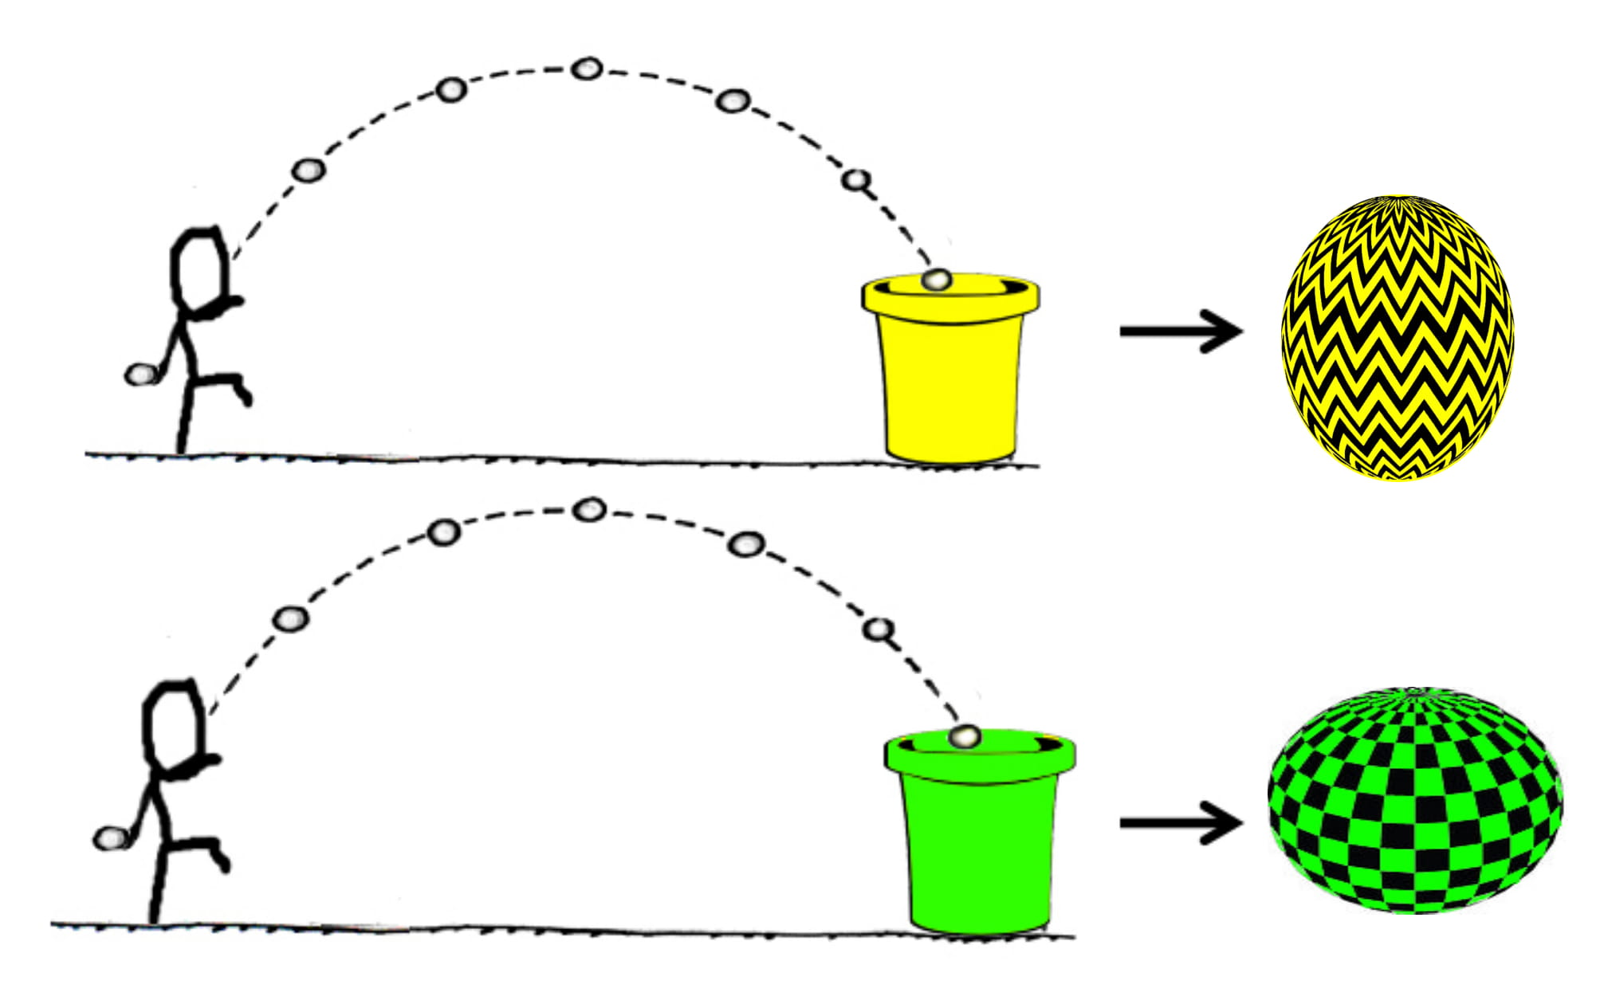
Context > Statistical evidence of property > Explanation > Measure essentialism
Gender-segregated classrooms
Novel behavior (playing games)
borrowed from Vasilyeva, Gopnik, & Lombrozo, 2018
Notes:
On the way to recess, each child stops a few steps away from the buckets and throws a pebble like this [demonstrate a throw], aiming for one of the buckets. If the pebble falls into the yellow bucket, that child plays Yellow-Ball that day. If the pebble, falls into the green bucket, that child plays Green-Ball that day. Do you see how this works?
- one or two kids asked what happens if the pebble doesn't land in any bucket, they get to throw again.

Slide 36
Context > Statistical evidence of property > Explanation > Measure essentialism
Nonstructural context
Structural context
bucket sizes counterbalanced
Different gender categories subject to equivalent social-structural contexts
Different gender categories subject to different social-structural contexts
memory check: bucket sizes in each classroom
borrowed from Vasilyeva, Gopnik, & Lombrozo, 2018
Notes:
Context manipulation – bucket sizes
eg These are the two buckets that are always set up in the girls' classroom. You can see that at the girls’ classroom, the bucket for Yellow-Ball is much bigger than the bucket for Green-Ball, so it’s much easier to get the pebble in the Yellow-Ball bucket than it is to get it in the Green-Ball bucket.
- Counterbalanced which bucket was bigger in the structural context * Language about difficulty -

Slide 37
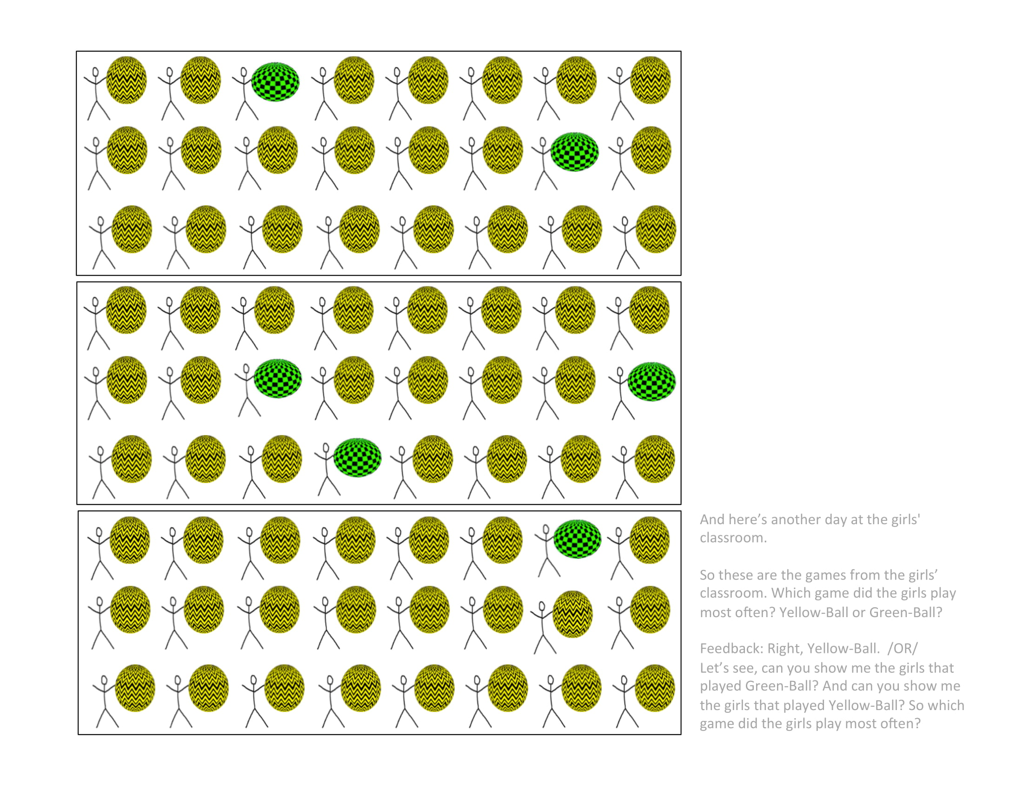
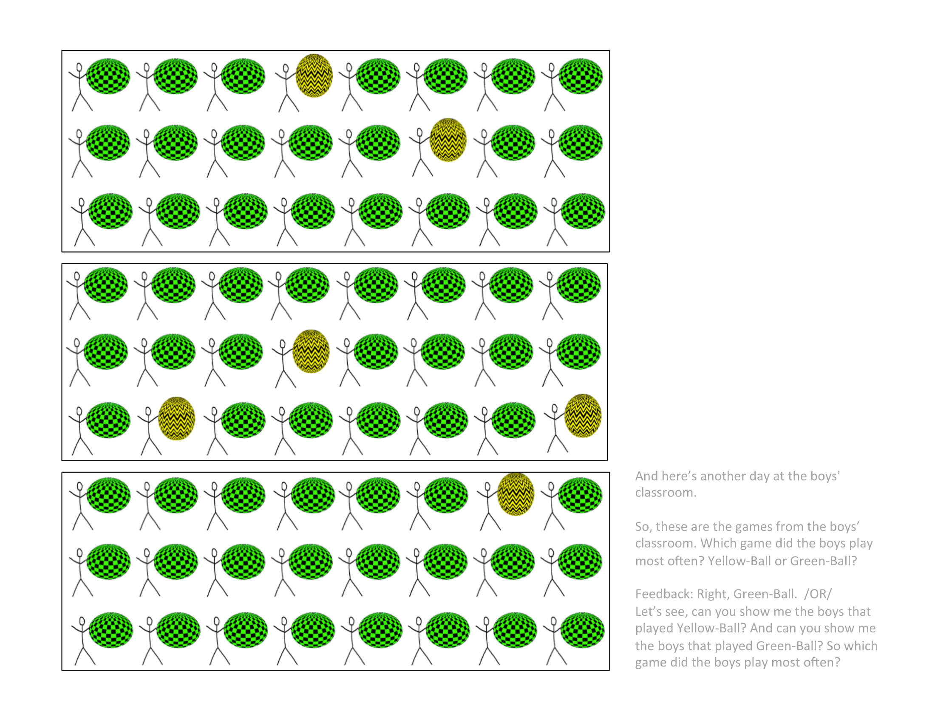
Context > Statistical evidence of property > Explanation > Measure essentialism
girls in girls’ classroom play a lot of Yellow-Ball
game
counterbalanced
boys in boys’ classroom play a lot of Green-Ball
memory check: game played most often by each gender
borrowed from Vasilyeva, Gopnik, & Lombrozo, 2018
Notes:
After seeing a nonstructural context or structural context, all participants then saw statistical evidence of girls playing a lot of Yellow-Ball, and boys playing a lot of Green-Ball.
Memory check for what game was played most often by each gender.
Nonstructural context – buckets are the same size, so should be equally likely to play either game. We know from prior work that given an unrepresentative skewed sample, like the game-playing behavior observed here, children will attribute a preference, so children in nonstructural context may think that different genders prefer different games (Kushnir, Xu, Wellman, 2010).
Structural context – buckets are different sizes, so skewed sample might just reflect the skew in bucket sizes, rather than anything intrinsic to each gender.
* Hyo: structural context - even stronger intuition of a preference for kids who end up playing game with smaller, more difficult bucket (green-ball)

Slide 38
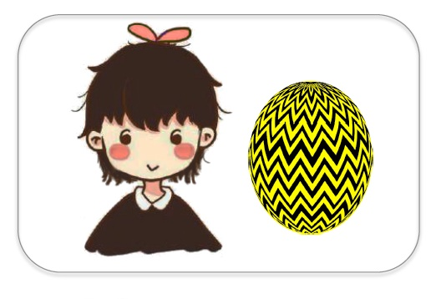
Context > Statistical evidence of property > Explanation > Measure essentialism
Control statement
Here’s Suzy. She is a girl. She plays Yellow-Ball.
Formal explanation
Here’s Suzy. She plays Yellow-Ball because she is a girl.
adapted from Muradoglu, Marchak, Cimpian, & Gelman, 2019
Notes:
Introduced to an individual category member
Explanation for why she plays Yellow-Ball
Fairly subtle manipulation

Slide 39
Context > Statistical evidence of property > Explanation > Measure essentialism
DVs from Muradoglu, Marchak, Cimpian, & Gelman, 2019
Notes:
Ppts have seen a nonstructural or structural context, and heard a control or formal explanation. Now we want to know what construal they are inferring from these two pieces of information.
Initial thought: let’s use the 5 canonical essentialism items from Muradoglu et al, and adapt them to this classroom context

Slide 40

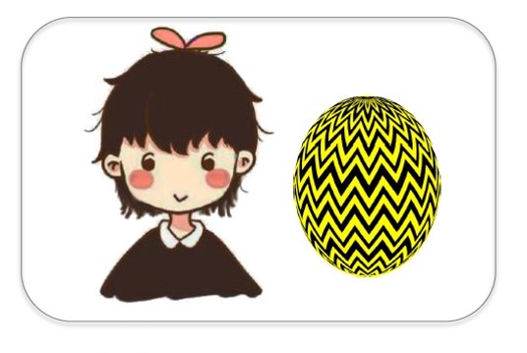







Context > Statistical evidence of property > Explanation > Measure essentialism
A canonical essentialism battery: 5 items
Stability past | Now, here’s a question for you: Suzy is 8 years old. Do you think she played Yellow-Ball when she was 4 years old? (Y/N)
Stability future | Do you think she will always play Yellow-Ball? (Y/N)
Innateness stop | Would Suzy stop playing Yellow-Ball if her family tried to stop her from playing Yellow-Ball? (Y/N)
Inductive potential | Do you think “just this girl,” “a few girls,” or “a whole lot of girls” play Yellow-Ball? (3-point)
Innateness switch | [Suzy goes to boys classroom] Which game do you think Suzy will play today? __ For sure __ or maybe __? (4-point)
------ Muradoglu et al, 2019 ------
Vasilyeva et al
Notes:
Here is the canonical 5-item essentialism battery used by prior studies, adapted to this paradigm. Stability over time x2
Innateness x2
Inductive potential

Slide 41
Context > Statistical evidence of property > Explanation > Measure essentialism
 |  | Essentialist | Structural
Stability past | Now, here’s a question for you: Suzy is 8 years old. Do you think she played Yellow-Ball when she was 4 years old? (Y/N) | Yes | Not same school: No Same school: Yes
Stability future | Do you think she will always play Yellow-Ball? (Y/N) | Yes | Not same school: No?
Innateness stop | Would Suzy stop playing Yellow-Ball if her family tried to stop her from playing Yellow-Ball? (Y/N) | No | No?
Inductive potential | Do you think “just this girl,” “a few girls,” or “a whole lot of girls” play Yellow-Ball? | A whole lot | At this school: A whole lot Outside school: ?
Innateness switch | [Suzy goes to boys classroom] Which game do you think Suzy will play today? __ For sure __ or maybe __? | For sure Yellow-Ball | For sure Green-Ball
A canonical essentialism battery: 5 items
------ Muradoglu et al, 2019 ------
Vasilyeva et al
Notes:
Characteristic answers to these questions that are considered to signal essentialism

Slide 42
Context > Statistical evidence of property > Explanation > Measure essentialism
 |  | Essentialist | Structural
Stability past | Now, here’s a question for you: Suzy is 8 years old. Do you think she played Yellow-Ball when she was 4 years old? (Y/N) | Yes | Not same school: No Same school: Yes
Stability future | Do you think she will always play Yellow-Ball? (Y/N) | Yes | Not same school: No?
Innateness stop | Would Suzy stop playing Yellow-Ball if her family tried to stop her from playing Yellow-Ball? (Y/N) | No | No?
Inductive potential | Do you think “just this girl,” “a few girls,” or “a whole lot of girls” play Yellow-Ball? | A whole lot | At this school: A whole lot Outside school: ?
Innateness switch | [Suzy goes to boys classroom] Which game do you think Suzy will play today? __ For sure __ or maybe __? | For sure Yellow-Ball | For sure Green-Ball
A canonical essentialism battery: 5 items
------ Muradoglu et al, 2019 ------
Vasilyeva et al
Notes:
But if we compare what someone
Besides for innateness switch, items don’t clearly tease apart essentialism from other ways of thinking

Slide 43
Context > Statistical evidence of property > Explanation > Measure essentialism
A new essentialism battery: 3 items averaged
 |  | Essentialist | Structural
Force-choice explanation | So, Suzy plays Yellow-Ball a lot at her school. Is it because Suzy likes playing Yellow-Ball, or is it because of the size of the buckets in her classroom? | Preference | Buckets
Inductive potential (without structural context) | Here’s Lucy. Lucy is a girl who doesn’t go to Kiki school. She goes to another school, where there aren’t any buckets. What game do you think Lucy will play? __ For sure __ or maybe __? (4-point) | For sure Yellow-Ball | Chance
Innateness switch | [Suzy goes to boys classroom] Which game do you think Suzy will play today? __ For sure __ or maybe __? (4-point) | For sure Yellow-Ball | For sure Green-Ball
-------- New-------
Vasilyeva et al
Notes:
After many rounds of piloting, we came up with a new battery to measure essentialism
Kept the innateness switch, 2 new DVs
Fc expl – pit preference against structural context. Preference isn’t a perfect way of getting at something deep and unobservable, which is the characteristic essentialist explanation, but it is an internal feature that we thought people thinking in an essentialist framework would prefer to reference over the structural context. Give us some purchase on teasing apart these two ways of thinking.
New inductive potential – introduce a new category member not subject to this context
Fixed order

Slide 44
Context > Statistical evidence of property > Explanation > Measure essentialism
A new essentialism battery: 3 items averaged
 |  | Essentialist | Structural
Force-choice explanation | So, Suzy plays Yellow-Ball a lot at her school. Is it because Suzy likes playing Yellow-Ball, or is it because of the size of the buckets in her classroom? | Preference | Buckets
Inductive potential | Here’s Lucy. Lucy is a girl who doesn’t go to Kiki school. She goes to another school, where there aren’t any buckets. What game do you think Lucy will play? __ For sure __ or maybe __? (4-point) | For sure Yellow-Ball | Chance
-------- New-------
Normative | Would it be okay or not okay for girls to play Green-Ball? | Not okay | Okay
Exploratory
Innateness switch | [Suzy goes to boys classroom] Which game do you think Suzy will play today? __ For sure __ or maybe __? (4-point) | For sure Yellow-Ball | For sure Green-Ball
Vasilyeva et al
Notes:
Also an exploratory normative measure.
since essentialism sometimes leads to normativity +
since prior work I had done on formal explanations had suggested that formal explanations lead to a normative violation when category members do not exhibit the property.
administered between the inductive potential and innateness switch items.

Slide 45
Context > Statistical evidence of property > Explanation > Measure essentialism
A new essentialism battery: 3 items averaged
 |  | Essentialist | Structural
Force-choice explanation | So, Suzy plays Yellow-Ball a lot at her school. Is it because Suzy likes playing Yellow-Ball, or is it because of the size of the buckets in her classroom? | Preference | Buckets
Inductive potential | Here’s Lucy. Lucy is a girl who doesn’t go to Kiki school. She goes to another school, where there aren’t any buckets. What game do you think Lucy will play? __ For sure __ or maybe __? (4-point) | For sure Yellow-Ball | Chance
Innateness switch | [Suzy goes to boys classroom] Which game do you think Suzy will play today? __ For sure __ or maybe __? (4-point) | For sure Yellow-Ball | For sure Green-Ball
-------- New-------
Vasilyeva et al
Notes:
But only these 3 items were averaged. Explain coding.

Slide 46
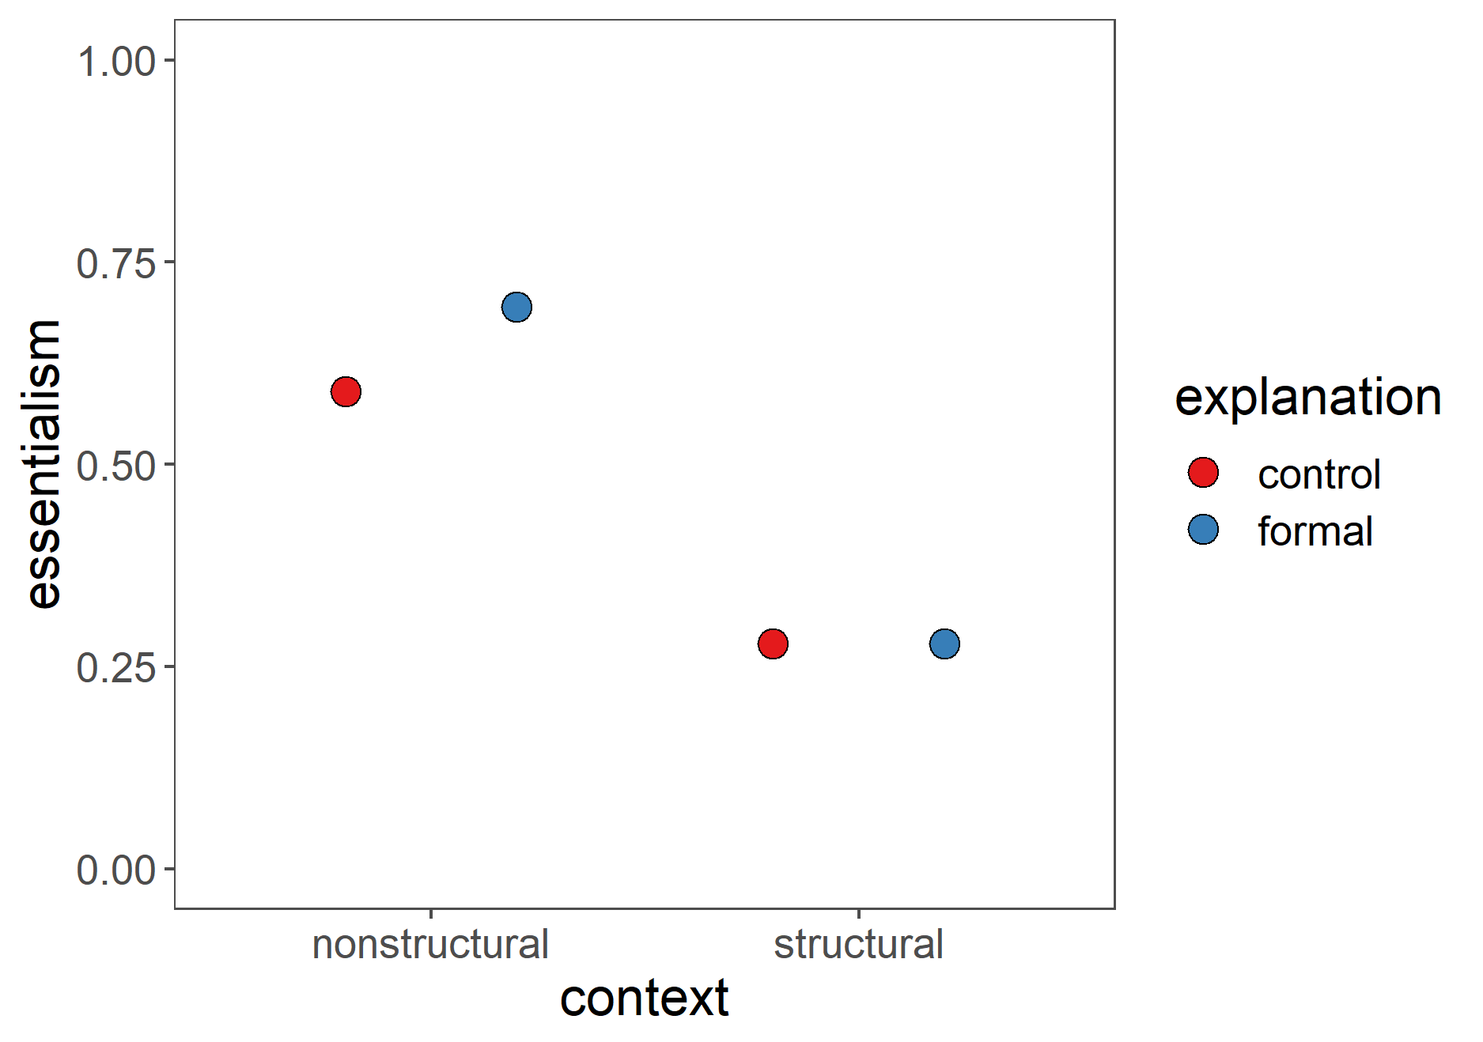
Context > Statistical evidence of property > Explanation > Measure essentialism
Notes:
Essentialism = for each subject, average 3 essentialism items, and then the averages over that. 1 is more essentialist, 0 is less.

Slide 47

A social-structural construal
Predictions
child
formal explanations boost
An essentialist construal
Formal explanations
prediction based on Muradoglu, Marchak, Cimpian, & Gelman, 2019
Notes:
Based on Muradoglu et al, predict that children will show the simple effect of formal explanations boosting essentialism in the nonstructural condition. We weren’t sure if we would see this boost in adults, since previous studies had only looked at the link between formal explanations and essentialism in children.

Slide 48
A social-structural construal
Predictions
child + adult
sensitivity to structural context
An essentialist construal
prediction based on Vasilyeva, Gopnik, & Lombrozo, 2018
Notes:
Based on Vasilyeva et al, predict that both children and adults will show a simple effect of structural context decreasing essentialism compared to a nonstructural context.

Slide 49

Predictions
child
context * explanation
An essentialist construal
Formal explanations
A social-structural construal
+
Notes:
The critical condition in our study is where a formal explanation is provided in a structural context. We thought that the structural context, compared to a nonstructural context, could decrease the boost in essentialism from hearing a formal explanation…

Slide 50
A social-structural construal
Predictions
child
context * explanation
An essentialist construal
Formal explanations
+
Notes:
…eliminate the boost…

Slide 51
Predictions
child
context * explanation
An essentialist construal
Formal explanations
A social-structural construal
+
Notes:
…or even reverse it. In other words, we predicted an interaction of context and explanation, which we preregistered as our hypothesis.

Slide 52
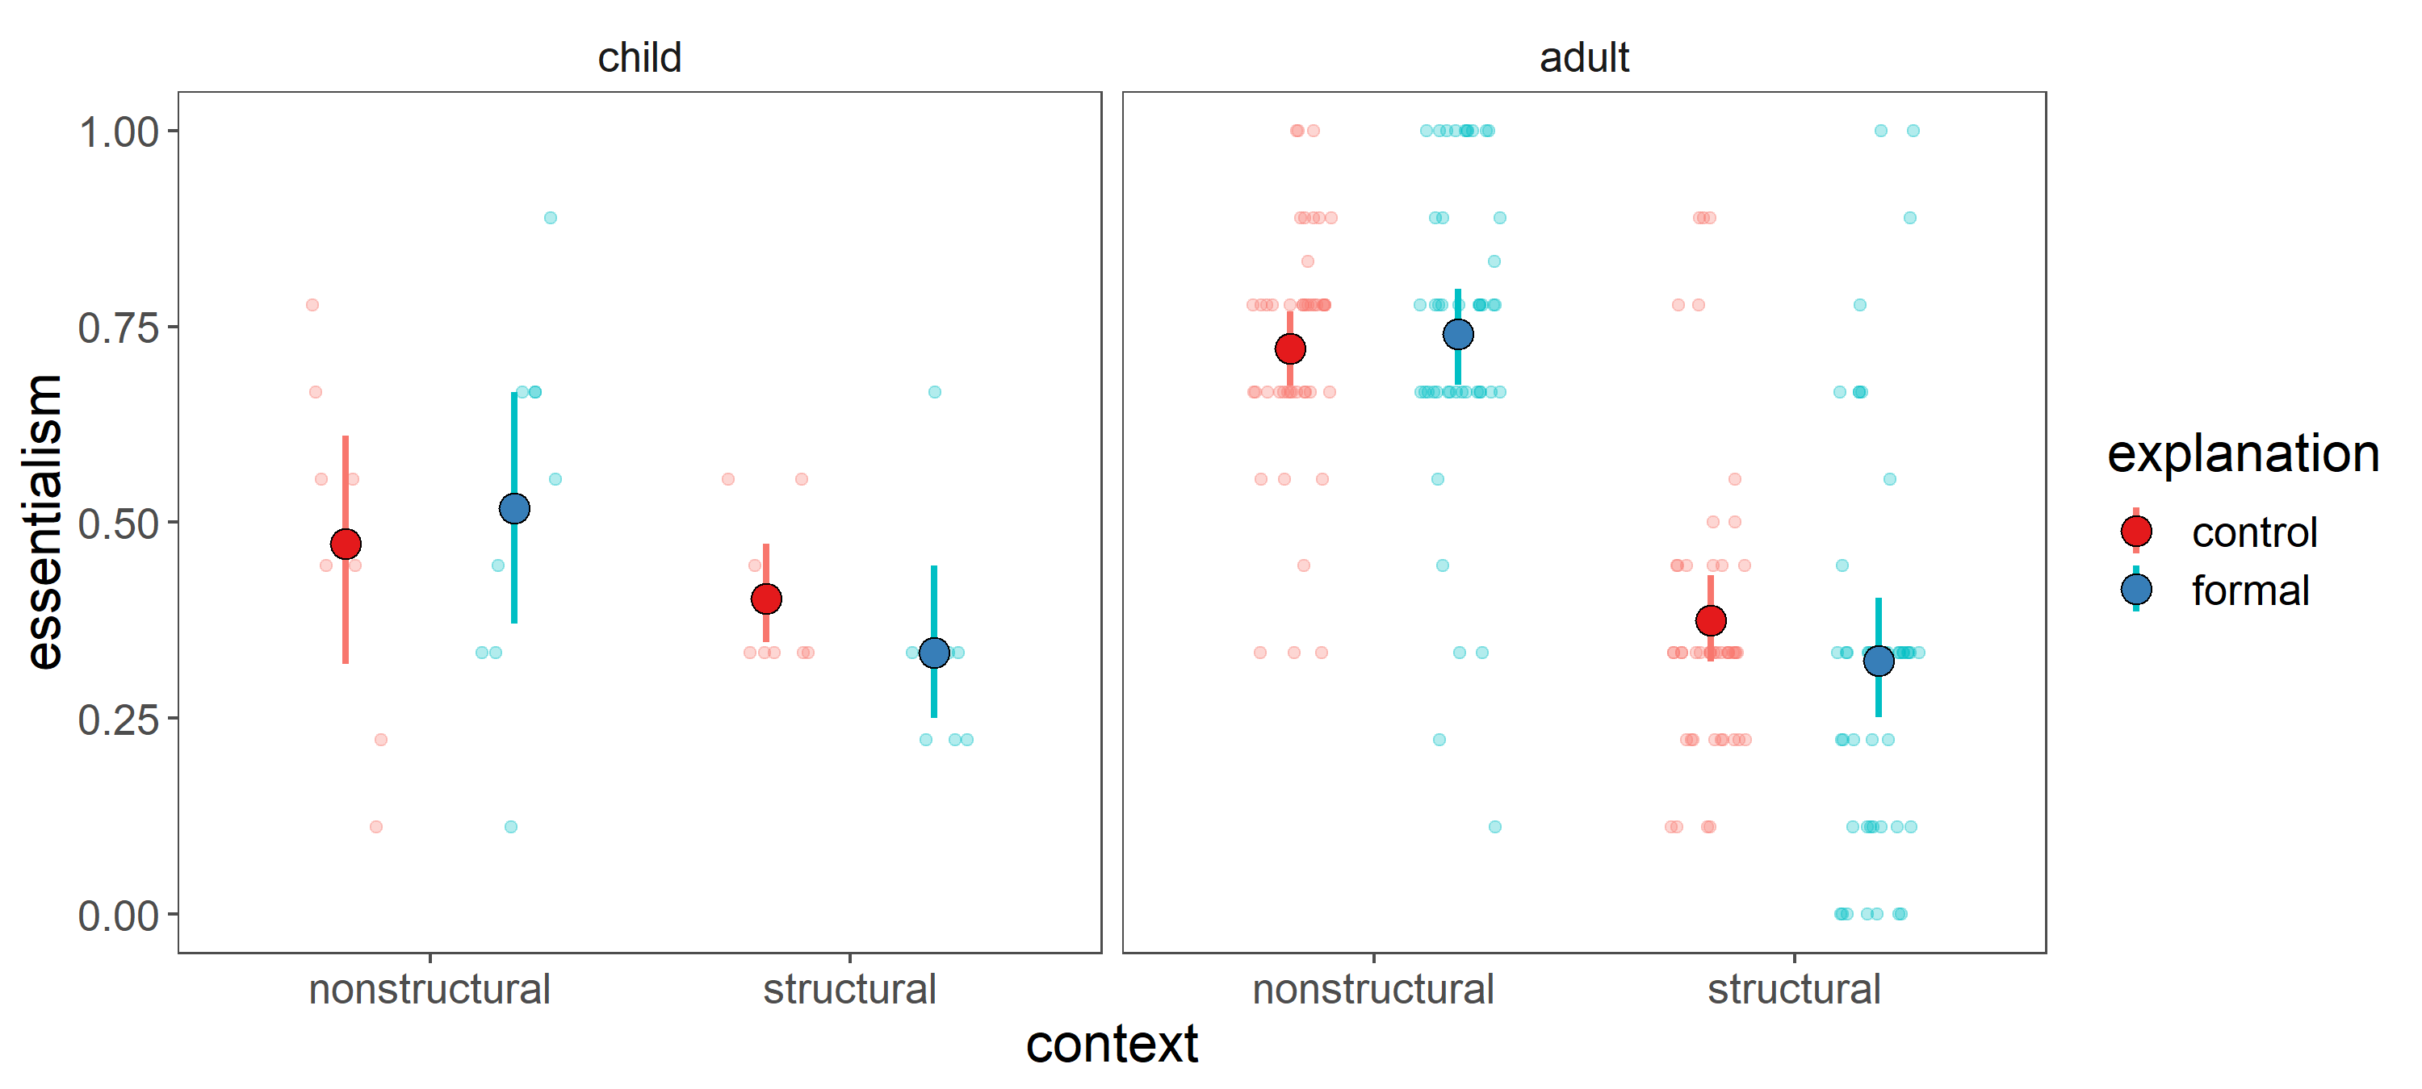
Results
data collection in progress
Error bars = 95% bootstrap CIs
N = 38 (~9/cell) out of target 196 (49/cell) 5 and 6 year olds
N = 183 (46/cell) adults
Notes:
What did we find?
show the results for the children and adults separately.
- first: children. heads-up: only 1/5 data collected, so disclaimer that what I’m about to show you is a very limited amount of data.

Slide 53
Results
data collection in progress
Error bars = 95% bootstrap CIs
N = 38 (~9/cell) out of target 196 (49/cell) 5 and 6 year olds
N = 183 (46/cell) adults
Notes:
Children: slight trends in the direction we’re predicting, but again hard to say anything with the limited amount of data.
Adults: luckily we have the entire data set, because MTurk studies run at lightspeed.

Slide 54
Results
data collection in progress
main effect of context
Error bars = 95% bootstrap CIs
N = 38 (~9/cell) out of target 196 (49/cell) 5 and 6 year olds
N = 183 (46/cell) adults
Notes:
Adults: rather than predicted context * expl, found a strong main effect of context
In line with the main effect of context that was found among adults in Vasilyeva et al. expecting to find a main effect, based on the prior results, but blown away by how strong the main effect is here. Naively: weak or no main effect of context, bc adults already have a lot of contextual knowledge about the structural factors in our society surrounding gender, a familiar category, even if this classroom paradigm and the game-playing property are novel.
Interesting that the adults aren’t affected at all by hearing the formal explanation. I didn’t have a strong prediction going in, since formal explanations and essentialism in adults hasn’t been well studied before. perhaps because adults hear about the context first, and the explanation later, the contextual information is so powerful that the formal explanation just gets interpreted in a way that falls in line with the construal suggested by the context.

Slide 55
An essentialist construal
Language provides information about how to represent a category.
Generic language
Formal explanations
Formal explanations
A social-structural construal
Notes:
To wrap up, language is a powerful source of information as children are constructing category representations. And whether we conceive of gender and other social categories in essentialist terms or social-structural terms is socially consequential, eg form the basis for stereotyping and prejudice, form the basis for differential policies, and justification for inequities in social structure.
Previous work has suggested that formal explanations, like generics, serve as a linguistic cue for what categories to essentialize.

Slide 56
An essentialist construal
Language provides information about how to represent a category.
Generic language
Formal explanations
Formal explanations
A social-structural construal
Formal explanations may be compatible with either construal, depending on contextual information about the structural factors at play.
+
Notes:
I’ve been really inspired by reading this previous literature, and would like to add the nuance that formal explanations may be more ambiguous than previously thought – they may not necessarily always yield an essentialist interpretation. In cases where there is a structural context present, formal explanations might yield a social-structural interpretation rather than an essentialist one.
- Another way of thinking about this is that the structural context “blocks” the essentialist reading of the formal explanation, and allows one to take a social-structural construal.
- Presented some intuitive reasons to think this is the case, and some preliminary data, but this is again an ongoing project.

Slide 57
An essentialist construal
Language provides information about how to represent a category.
Generic language
Formal explanations
Formal explanations
A social-structural construal
Formal explanations may be compatible with either construal, depending on contextual information about the structural factors at play.
+
How do children integrate linguistic and contextual information when developing category representations?
Notes:
To return to the question that I had opened the talk with, I think of this project as an initial foray into the question of how children integrate linguistic and contextual information when developing category representations, which I would be excited to explore further in future work.

Slide 58
An essentialist construal
Language provides information about how to represent a category.
Generic language
Formal explanations
Formal explanations
A social-structural construal
Formal explanations may be compatible with either construal, depending on contextual information about the structural factors at play.
+
How do children integrate linguistic and contextual information when developing category representations?
What are formal explanations? When do we produce them?
How do we interpret them?
“…simply/just because…”?
Notes:
This project has also gotten me excited about another open question, about the nature of formal explanations. Formal explanations are really puzzling and fascinating to me for a variety of reasons. - I mentioned earlier that they present an interesting puzzle: they sound tautological and uninformative, yet we find them natural and meaningful.
I hope I’ve been able to suggest here that their interpretation might shift in really contextually dependent and interesting ways.
But you might wonder, given this slipperiness about how to interpret a formal explanation, why do we produce formal explanations at all? Why don’t we produce alternative explanations that are clear and unambiguously essentialist or social-structural? Instead of “I walk in groups late at night because I’m a woman”, I could say “I walk in groups late at night because the likelihood of women being targeted for gender-based harassment and violence increases during the night hours”. Principles of brevity. But also maybe social-structural factors are in the common ground.
Subtle change of adding “simply because I’m a woman” or “just because I’m a woman” seems to change the interpretation, people have different intuitions though.
Despite their interpretative slipperiness, formal explanations can be really powerful cues. They directly link an individual and a property to an entire category, such that they could support learning about an entire category from an individual. In this sense, I’m really interested in untangling this puzzle to learn more about how language can support category learning.

Slide 59



github.com/mariannazhang/structuralblocking
Ellen Markman
Cai Guo
Kara Weisman
Lin Bian
Derek Powell
Hyo Gweon
Mika Asaba
Natalia Vélez
Sophie Bridgers
Grace Bennett-Pierre
Griffin Dietz
Yang Wu
Mike Frank
Steven Roberts
Thanks!
Adult participants on MTurk
Chia-Wa Yeh
Jennifer Winters & Beth Wise
Children, families, & teachers
Nadya Vasilyeva
Kristan Marchak
Melis Muradoglu
Regina Casper Stanford Graduate Fellowship in Science & Technology
Alexandra Schindler
Children & families
Notes:
devo area, cohort, dept for being so welcoming, helping me feel like I belong in community * how are generics and formal explanations related? Hunch: intimately related, open question exactly how. formal explanations do generically invoke the category. My guess is that formal explanations build on generics, going further by specifying that the category is somehow *the reason* for possessing the property, which allows them to be explanations rather than just statements. Would be interesting to probe when each are produced.
* variability at category level (what categories are essentialized), property level (what properties are essentialized for a given category, or tend to be essentialized across categories). Thinking about ess vs soc-str construals as a continuum, with intermediate
* relate to social attribution - something about the internal character, or something about the general situation. Social-structural forces aren’t just present for an individual in a one-time situation, these are stable forces acting on a category by virtue of the whole social context that it exists within
* vicious circle - social-structural context -> inherent properties, eg preference -> reinforce the very social-structural contexts that produced them (eg dept stores: lots of pink for girls' clothing, girls develop preference for pink, stores justify it in that there's demand for those clothes). structural contexts could end up reflecting something internal. Reasoning about root causes, inherence heuristic (Cimpian), statistical confound of context and inherent properties, contingency vs necessity.

Slide 60
Notes:
* vicious circle - social-structural context might influence internal factors like preference, which then might encourage the very social-structural contexts that produced them (eg dept stores: lots of pink for girls' clothing, girls develop preference for pink, stores justify it in that there's demand for those clothes). structural contexts could end up reflecting something internal
> what's the root cause?
> Mika: maybe ppt think preference causes social-structural context? teacher sets up buckets in that way because of demand/interest/preference
> the order of first language then context might suggest that context is a result of internal factors
> Ellen: inherence heuristic (Cimpian). might think that there's a good reason, even though it's culturally arbitrary, can end up turning into something that people think have a real inherent feature.

Slide 61
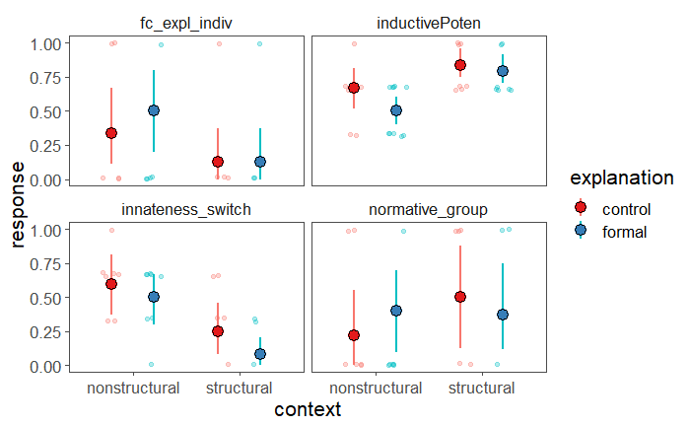
Child data by DV
Inductive potential:
Why the context pattern?
N = 38 (~9/cell) out of target 196 (49/cell) 5 and 6 year olds

Slide 62
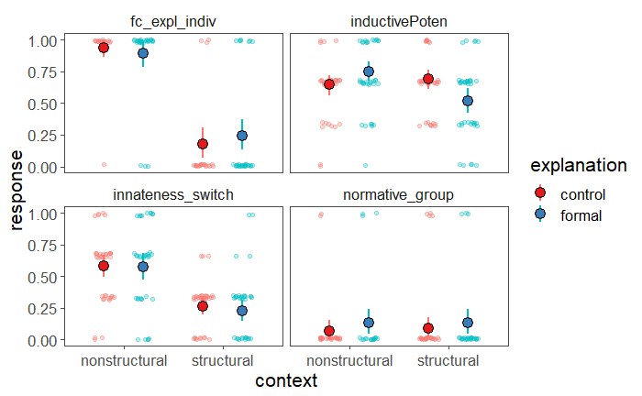
Adult data by DV
N = 183 (46/cell) adults

Slide 63
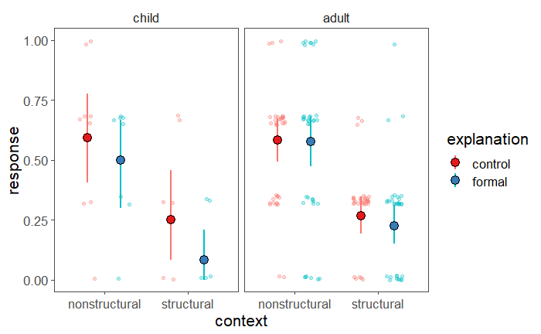
Innateness switch item
N = 38 (~9/cell) out of target 196 (49/cell) 5 and 6 year olds
N = 183 (46/cell) adults
Notes:
0 = “For sure Green-Ball”, 1/3 = “Maybe Green-Ball”, 2/3 = “Maybe Yellow-Ball”

Slide 64
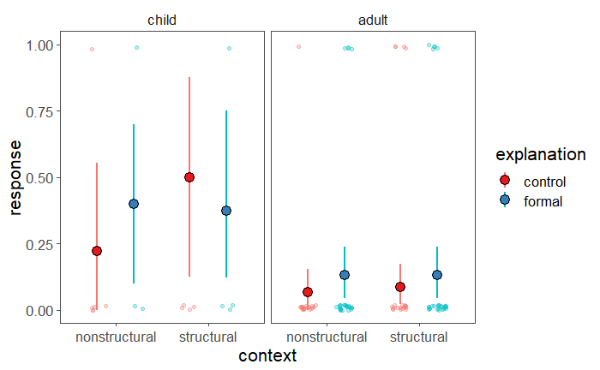
Exploratory measure of normativity
N = 38 (~9/cell) out of target 196 (49/cell) 5 and 6 year olds
N = 183 (46/cell) adults
Notes:
0 being “okay”, 1 being “not okay” to play the other game
Floor effects with adults, although trending like formal explanations boost normativity
Cf my work with Susan – formal explanations generate an expectation that category members will possess the property, and when category members don’t, there’s a normative violation generated

Slide 65
Pilot 1 DVs
Stability past | Now, here’s a question for you: Suzy is 8 years old. Do you think she played Yellow-Ball when she was 4 years old? (Y/N)
Stability future | Do you think she will always play Yellow-Ball? (Y/N)
Innateness stop | Would Suzy stop playing Yellow-Ball if her family tried to stop her from playing Yellow-Ball? (Y/N)
Inductive potential | Do you think “just this girl,” “a few girls,” or “a whole lot of girls” play Yellow-Ball?
Innateness switch | [Suzy goes to boys classroom] Which game do you think Suzy will play today? __ For sure __ or maybe __?
--- Muradoglu et al, submitted ---
Vasilyeva et al

Slide 66
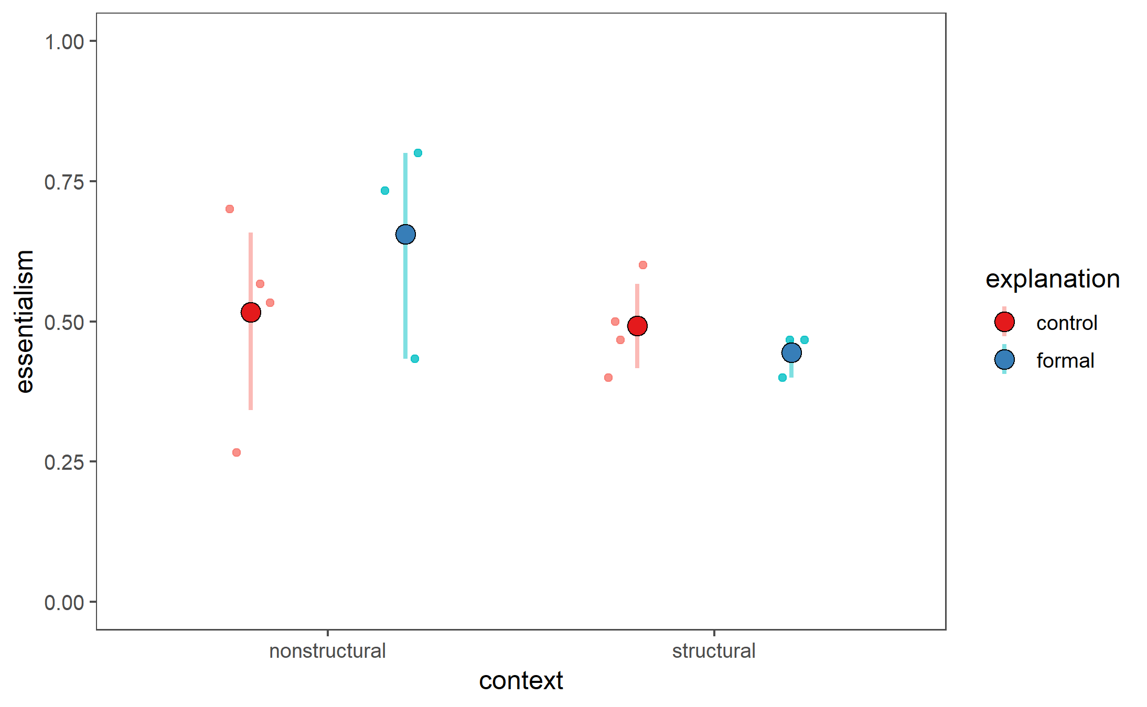
Pilot 1 data
5 canonical items
N = 14 5 and 6 year olds

Slide 67
Pilot 2 DVs
 | 2.1 | 2.2 | 2.3
 | n=4 (all structural) | n=9 | n=7
Force-choice explanation | group | indiv | indiv, “the size”
Inductive potential – new category member | 2 point response |  | 4 point response
Normative | indiv | group
Innateness switch | same
----------- New ------------
Vasilyeva et al
Notes:
Note that 2.2 and 2.3 are very similar, so I’ll show some plots with data combined from both versions, where the inductive potential responses from 2.2 are coded as the midpoint between the two lateral points from 2.3

Slide 68
Pilot 2 DVs
 |  | Essentialist | Structural
Force-choice explanation | (2.2/2.3 indiv) So, Suzy plays Yellow-Ball a lot at her school. Is it because Suzy likes playing Yellow-Ball, or is it because of the size of the buckets in her classroom? (2.1 group) So, the girls in the girls’ classroom play Yellow-Ball a lot at their school, and the boys in the boys’ classroom play Green-Ball a lot at their school. Is it because girls and boys like playing with different balls, or is it because of the buckets in their classrooms? | Preference | Buckets
Inductive potential – new category member | Here’s Lucy. Lucy is a girl who doesn’t go to Kiki school. She goes to another school. (show the balls, no buckets) What game do you think Lucy will play? ___ (2.3) For sure __ or maybe __? | Yellow-Ball | Chance
Normative | (2.2/2.3group) Would it be okay or not okay for girls to play Green-Ball? (2.1 indiv) Here’s Katie. Katie is a girl who plays Green-Ball. Is it okay or not okay for Katie to play Green-Ball? (okay/not okay) | Not okay | Okay
Innateness switch | [Suzy goes to boys classroom] Which game do you think Suzy will play today? ___ For sure __ or maybe __? | For sure Yellow-Ball | For sure Green-Ball
-------------------- New ---------------------
Vasilyeva et al

Slide 69
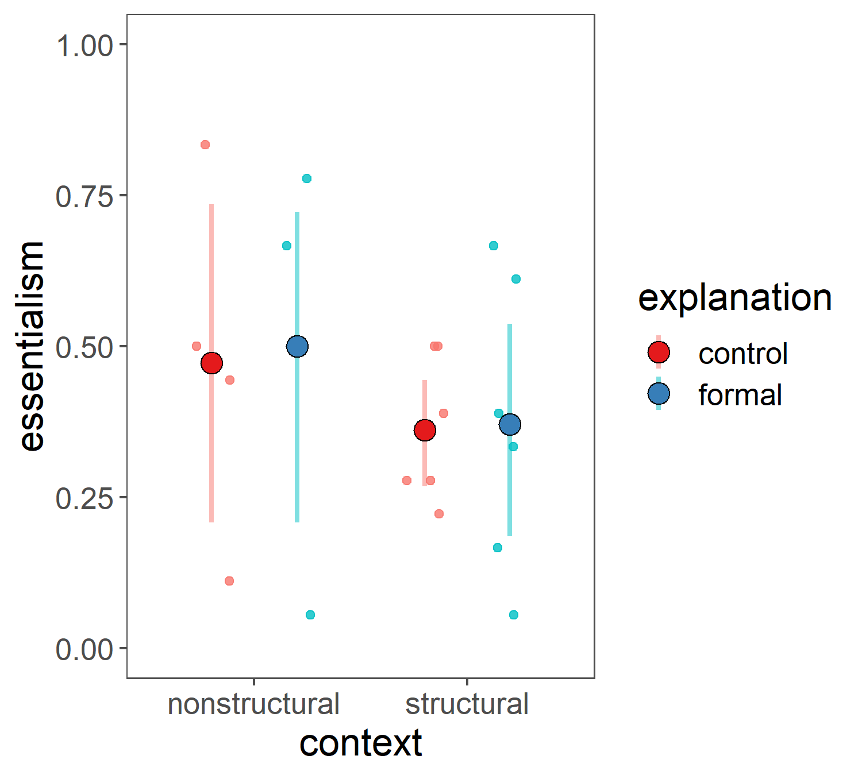
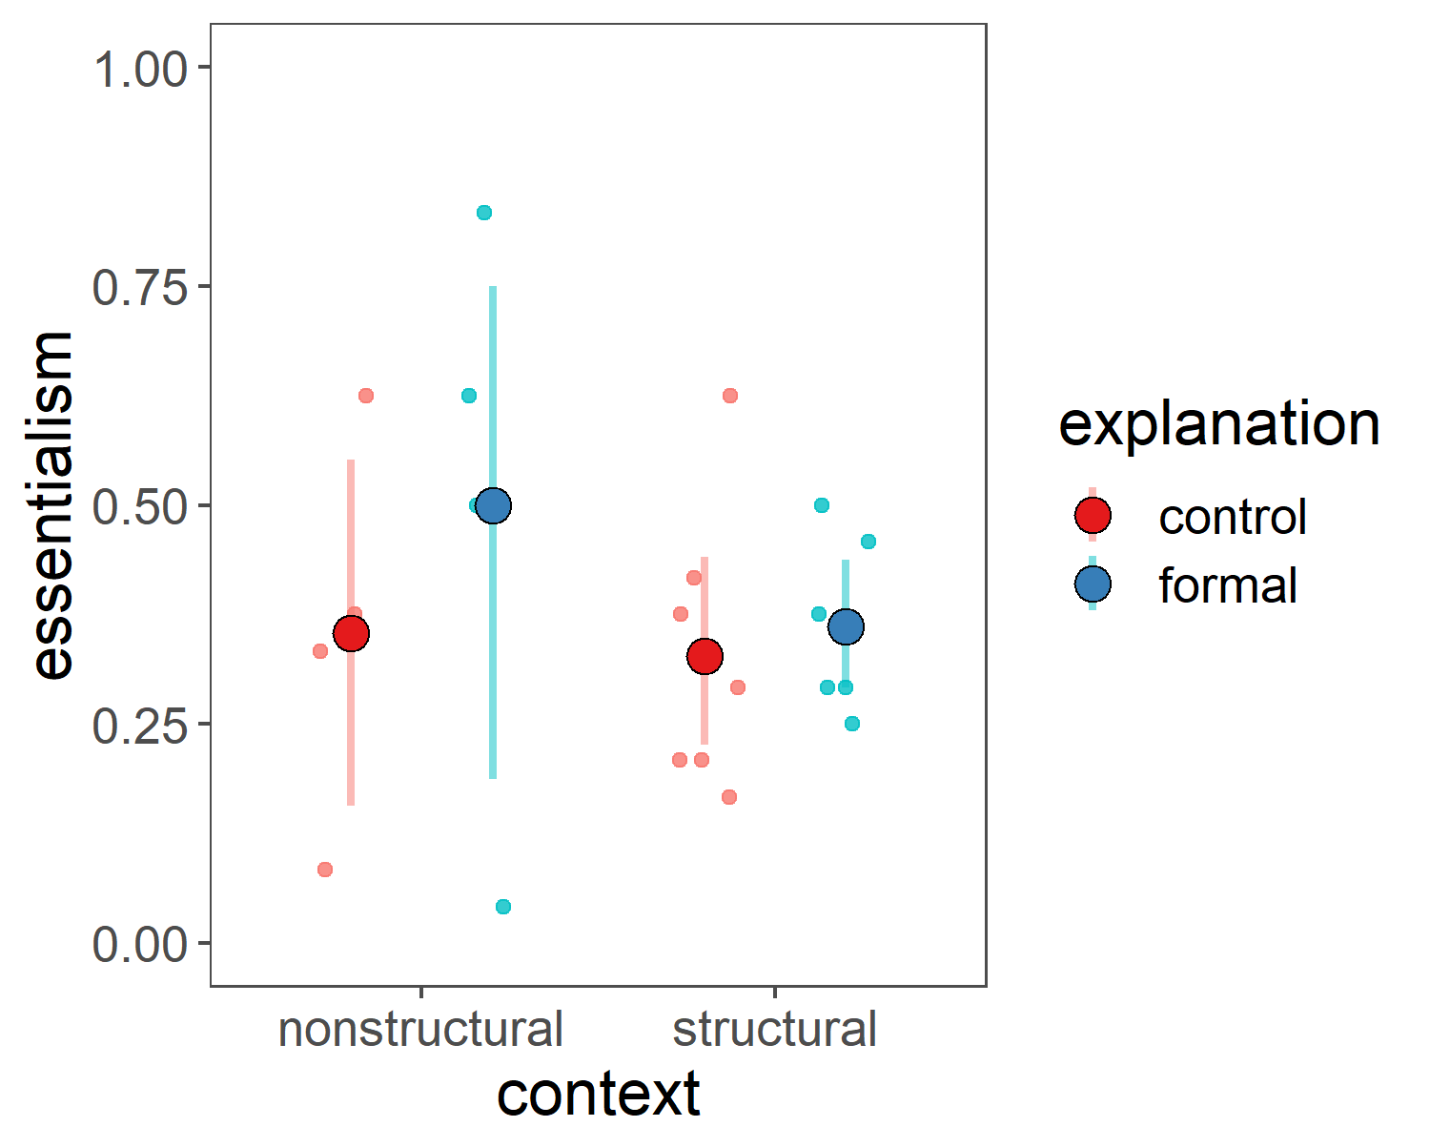
Pilot 2 all data
3 items
3 items + normative
N = 20 5 and 6 year olds

Slide 70
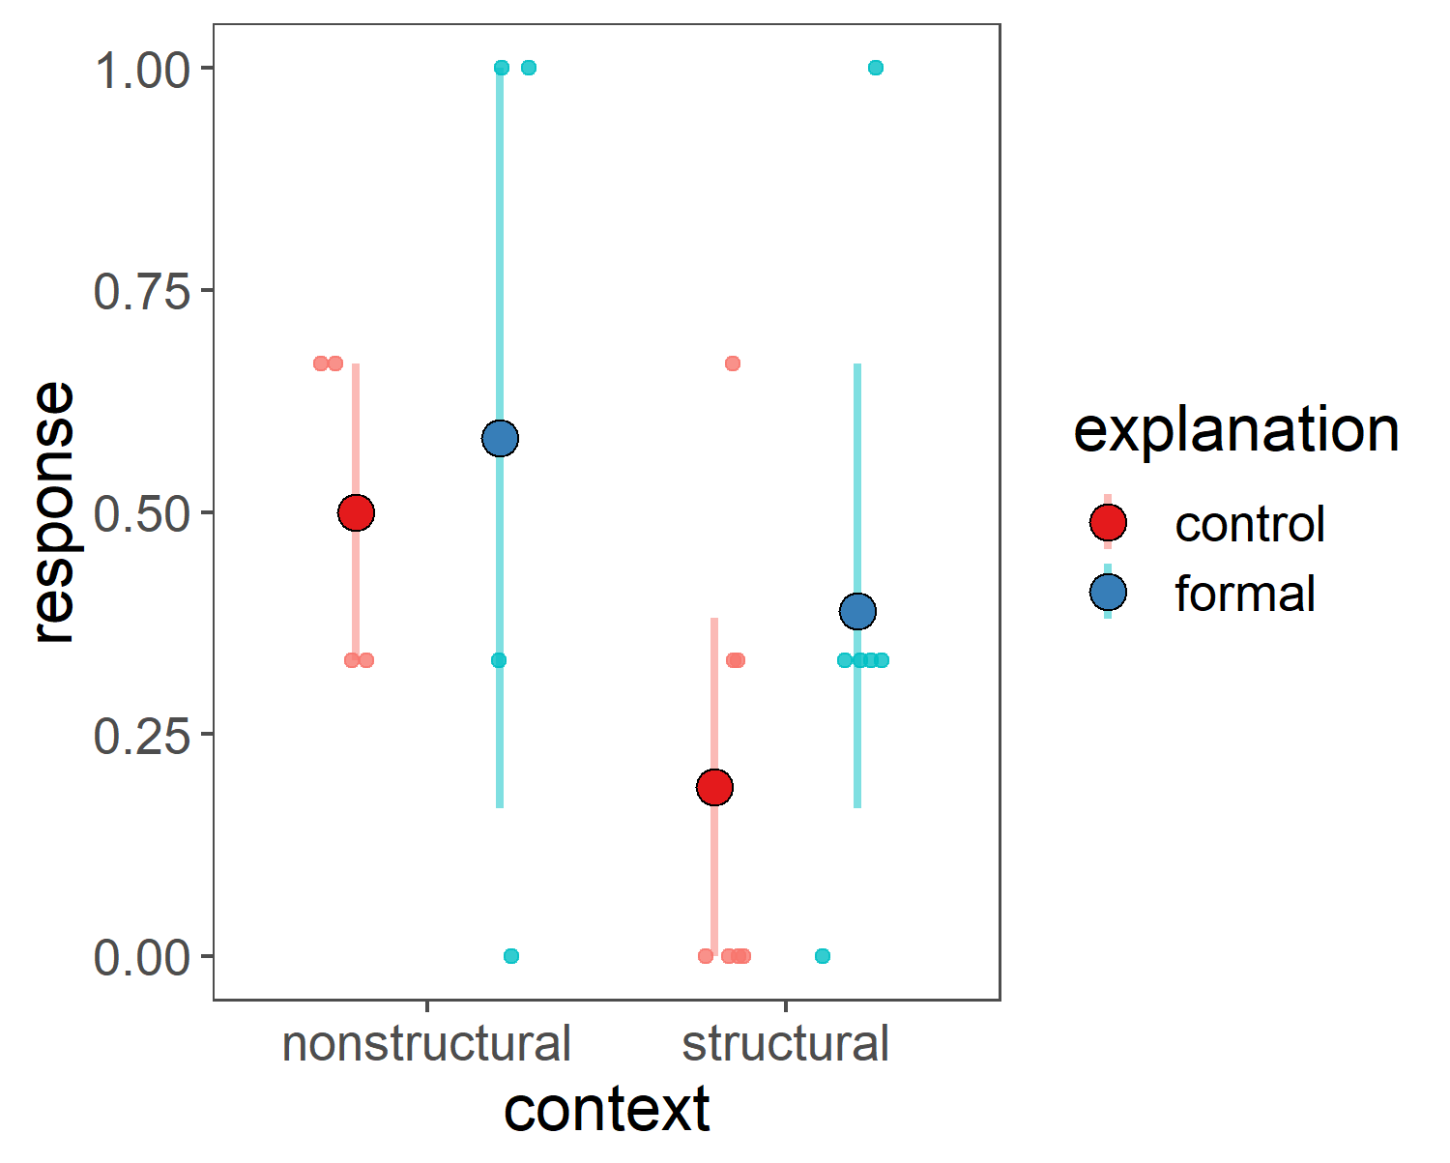
Pilot 2 all data
3 items
innateness switch only
N = 20 5 and 6 year olds

